Slide 1
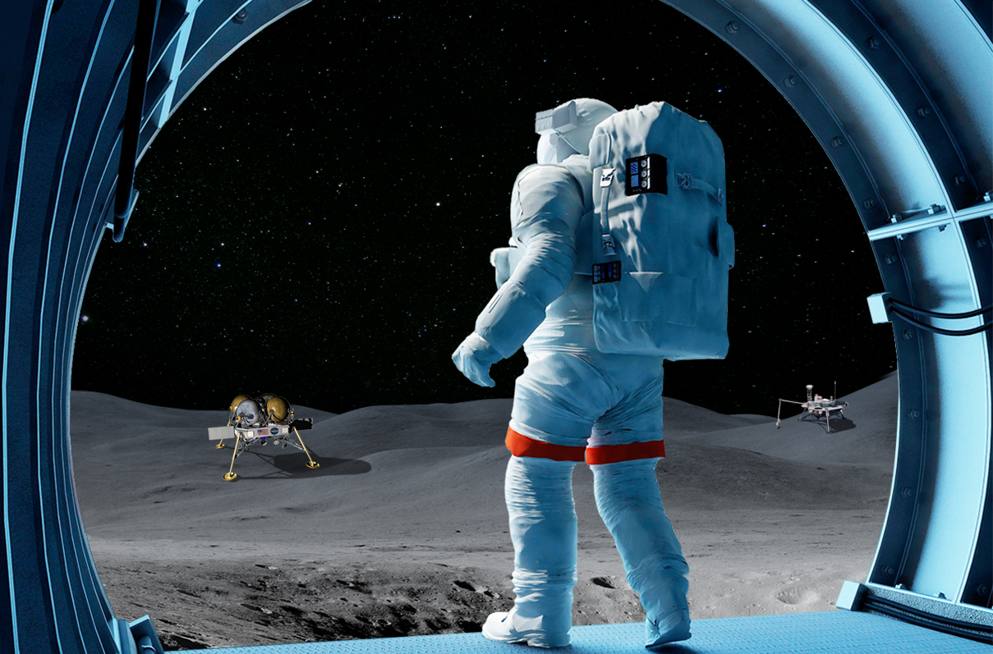
Space Science 101 – Fundamental Physics and Quantum Technologies
Ulf Israelsson, Jet Propulsion Laboratory, California Institute of Technology
American Society for Gravitational and Space Research, Washington D.C.,
Oct 31, 2018
© 2018 California Institute of Technology. Government Sponsorship Acknowledged.
Image Credit
NASA Space Life and Physical Science Research and Application Division

Slide 2
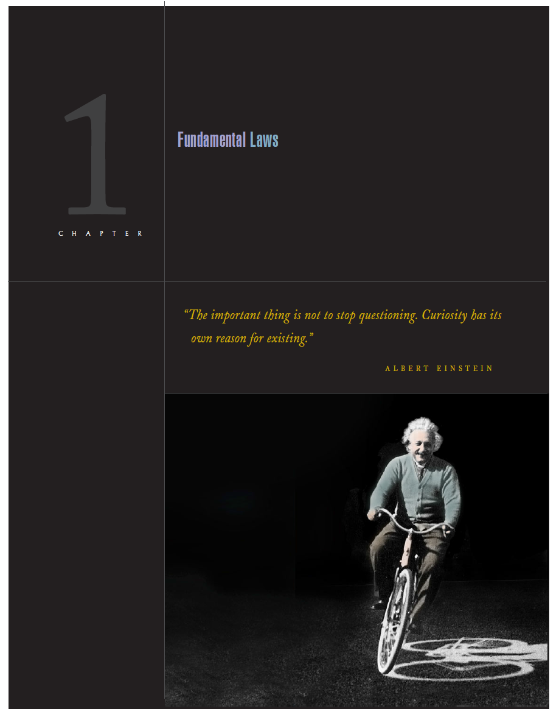
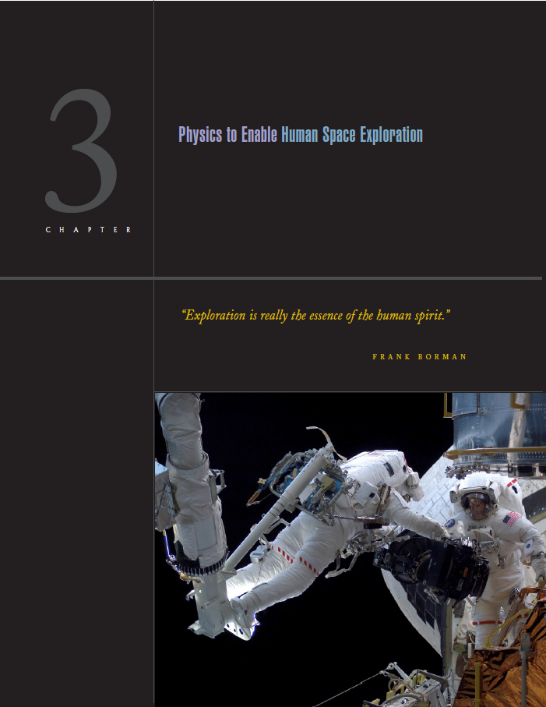

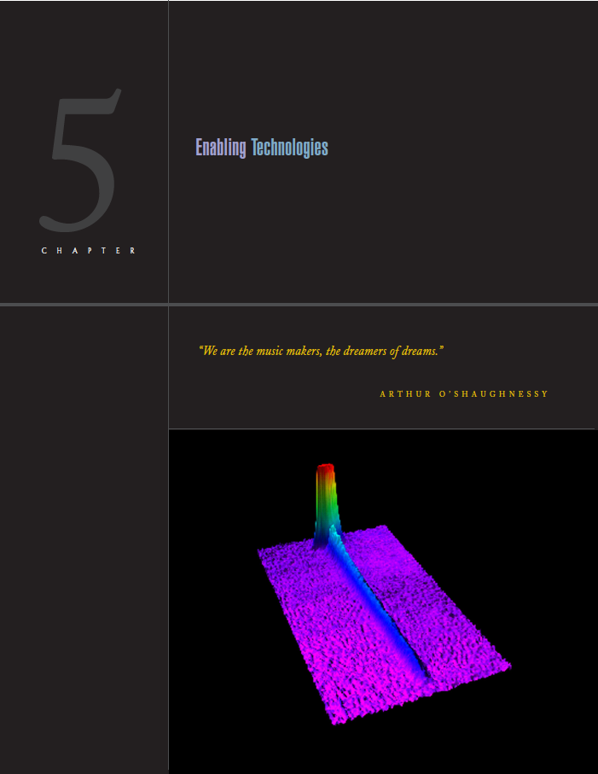
Fundamental Physics and Quantum Technologies
Fundamental Physics Research in Space aims to pioneer scientific discovery, enable exploration, and benefit society on Earth
The fundamental physics research of yesterday is the sensor of today, so too is the fundamental physics research of today directly enabling the products of tomorrow.
Discover and Explore Fundamental Physical Laws Governing Matter, Space, and Time
Apply physics results to enable technologies that allow human space exploration far beyond what is possible today.
To Apply physics insights to enable Earth-based applications that promote industrial prowess and enhance national security.
Discover and Understand Organizing Principles of Nature from which Structure and Complexity Emerge

Slide 3
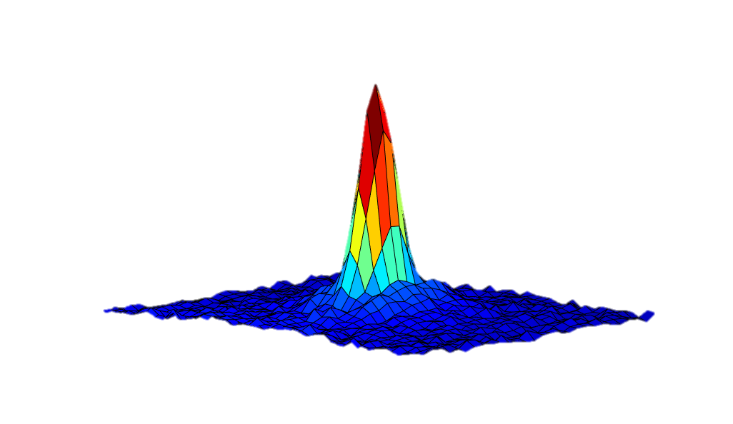
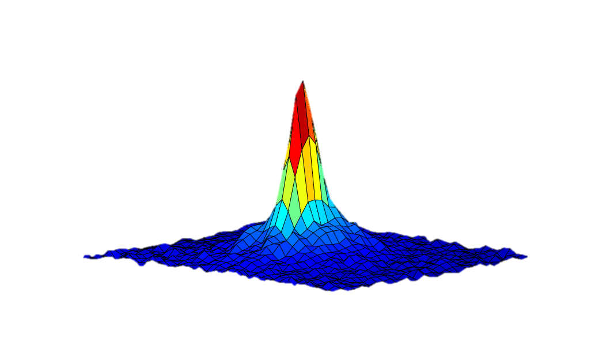
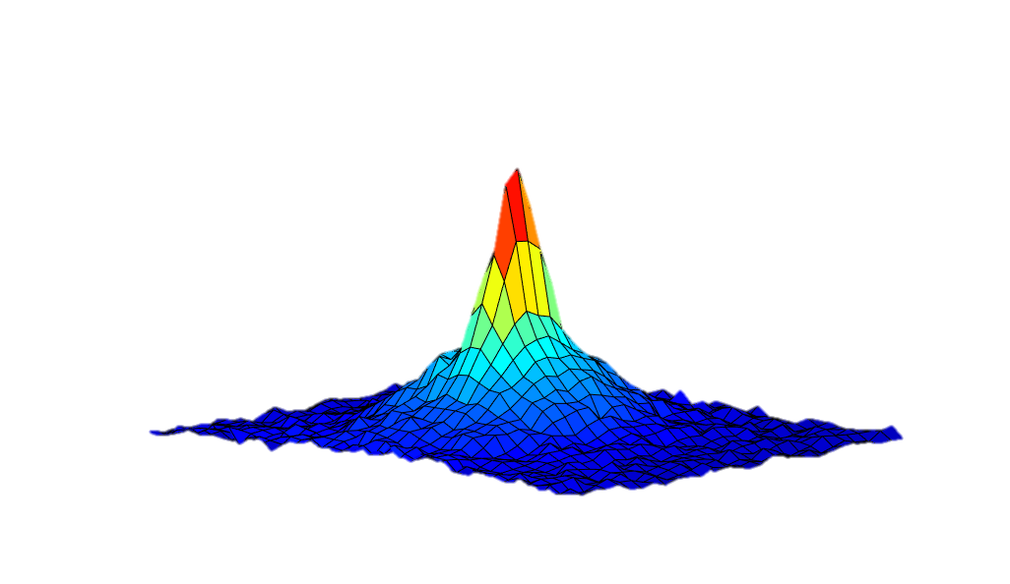
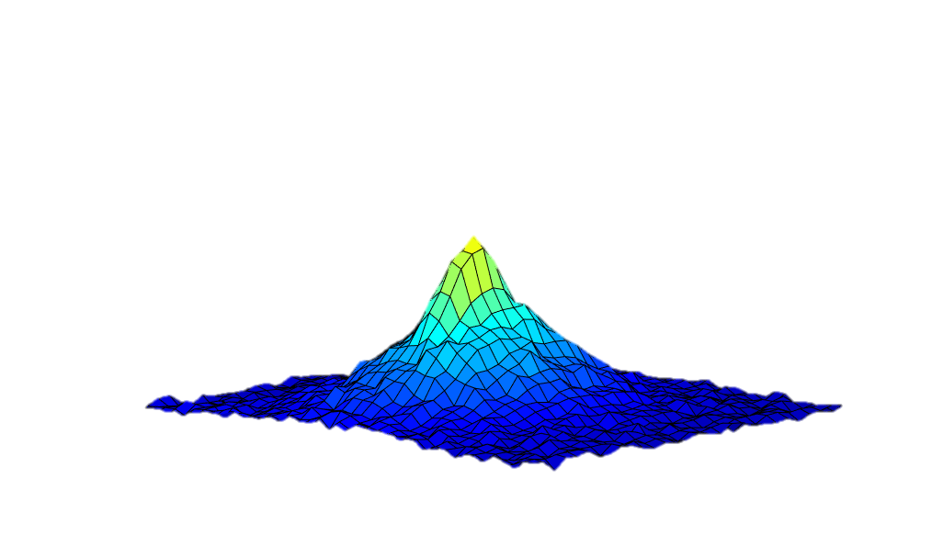
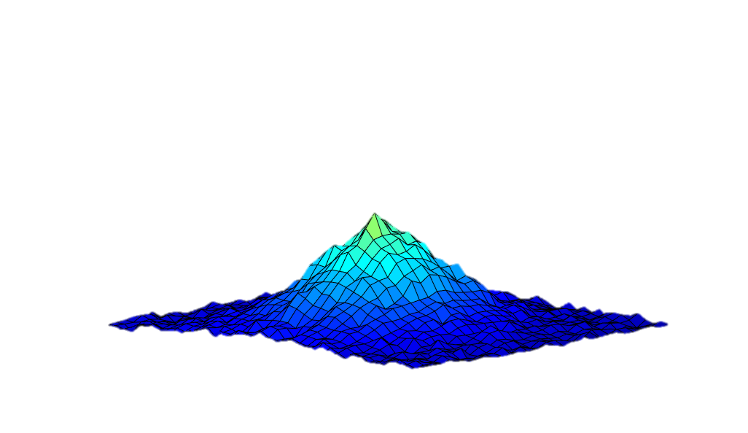
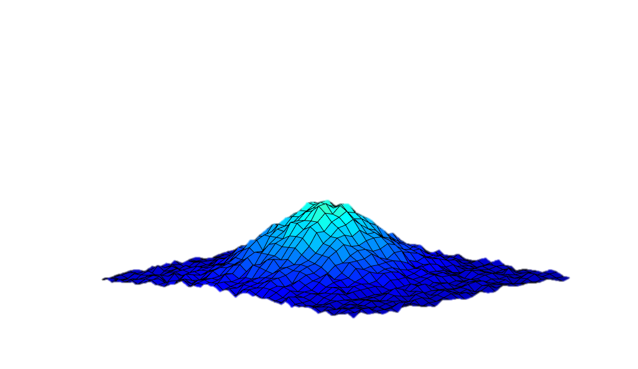
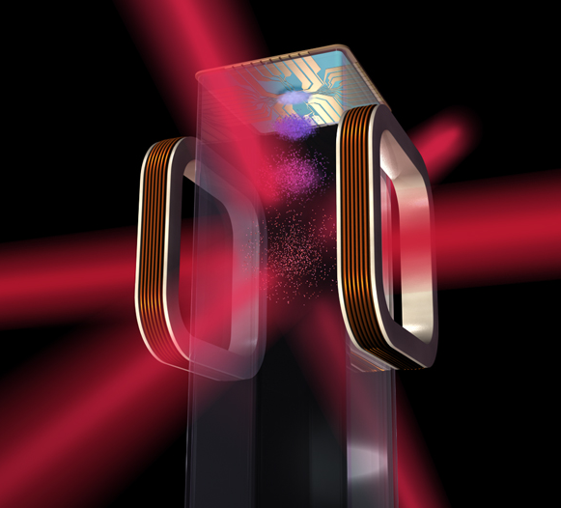
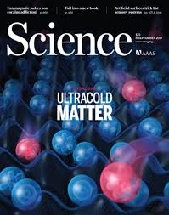
Cold Atom Research
CAL
NASA’s Cold Atom
Laboratory on the ISS
CAL State-of-the-art quantum sensor technology
T < 1 nano-Kelvin above absolute zero
Bose Einstein Condensation
Observation time exceeds 1 second
Enabling quantum exploration technology
Image Credit
CAL
BECCAL
CAL follow-on under development jointly by DLR and NASA
Image Credit
DLR

Slide 4
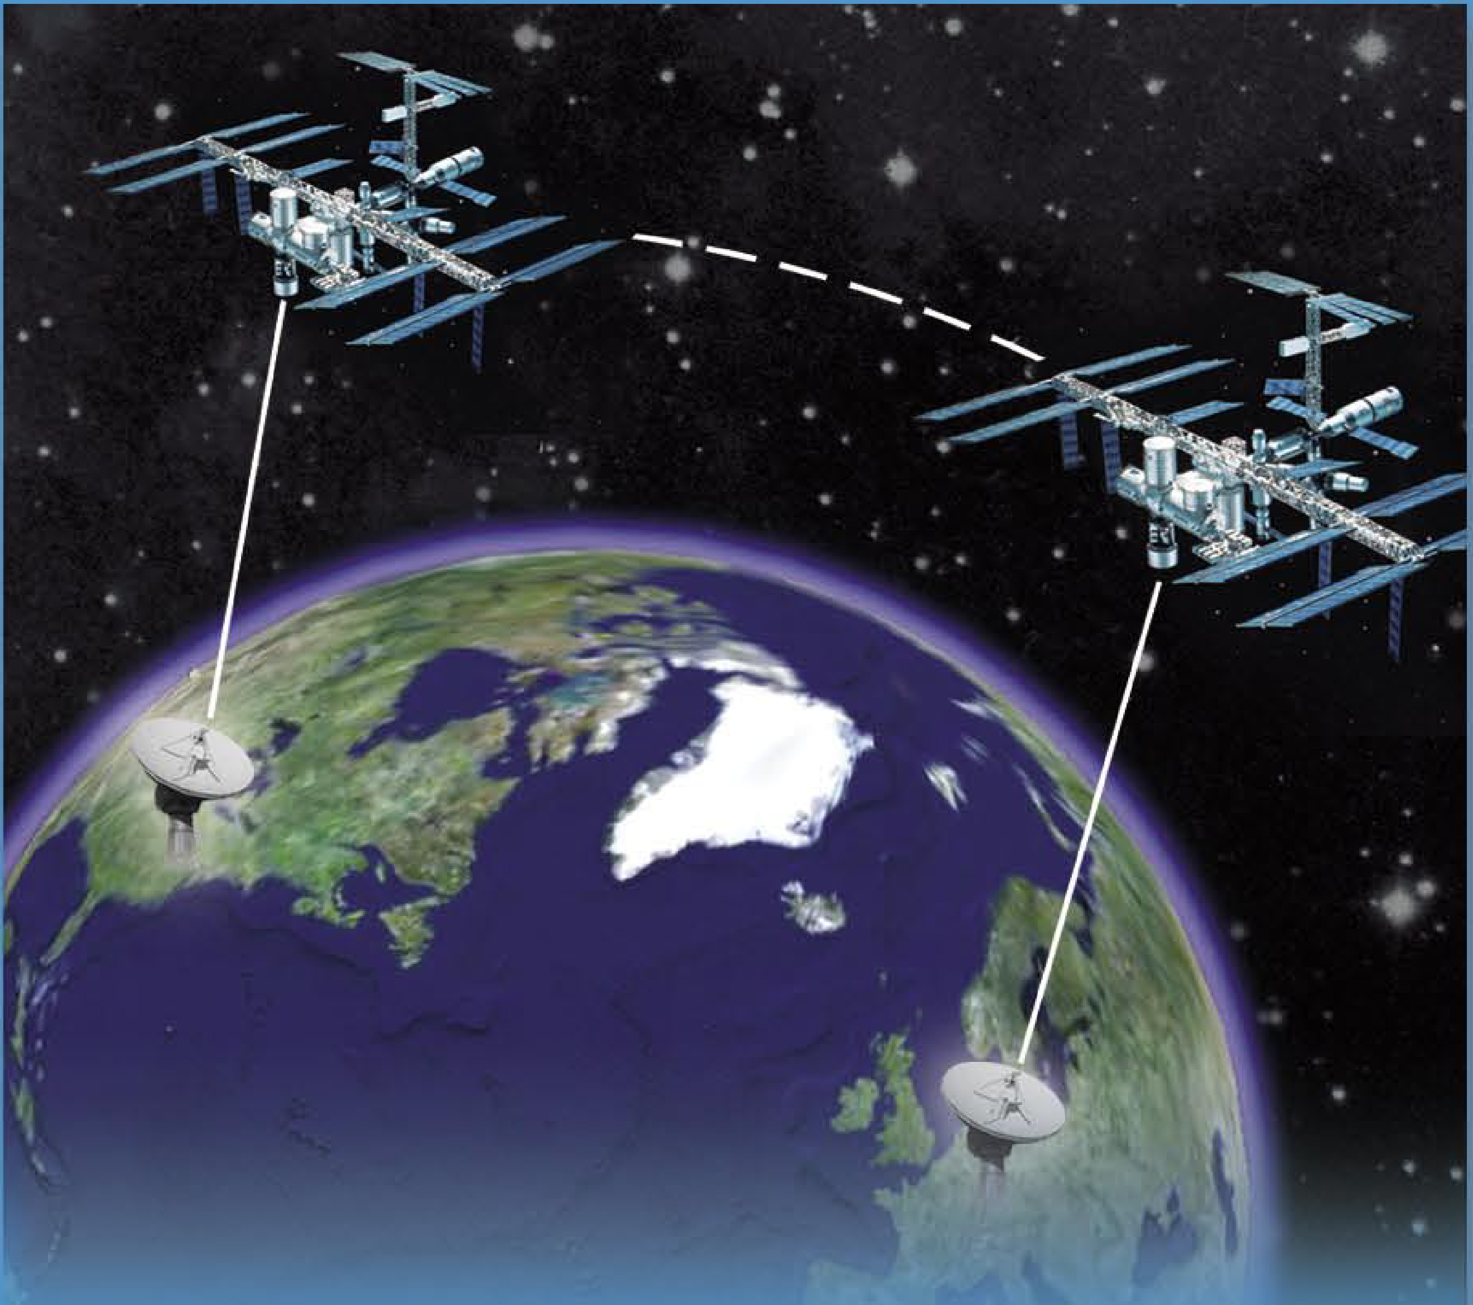
Fun Physics Facts
As explained by Einstein’s Relativity Theories
Time moves slower the faster you move
Time moves slower the closer you are to a large mass, like the Earth.
  Time on a GPS satellite runs about 38 microseconds faster per day than time on Earth.
  This amounts to a 10 km daily GPS error if left uncorrected.
The European Space Agency ACES Project
Atomic Clock Ensemble in Space on the ISS
Time from ground clocks in the U.S. will be compared to ACES time.
Today’s state-of-the-art optical clocks would be off less than 1 second starting from the beginning of time itself.
Image Credit
European Space Agency
Image Credit - European Space Agency

Slide 5
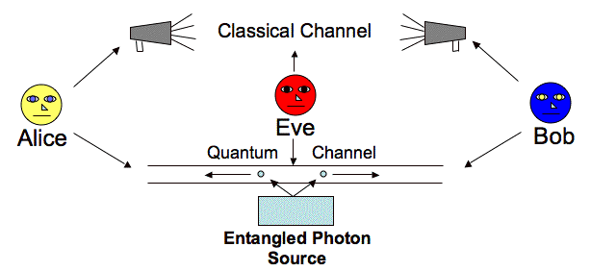
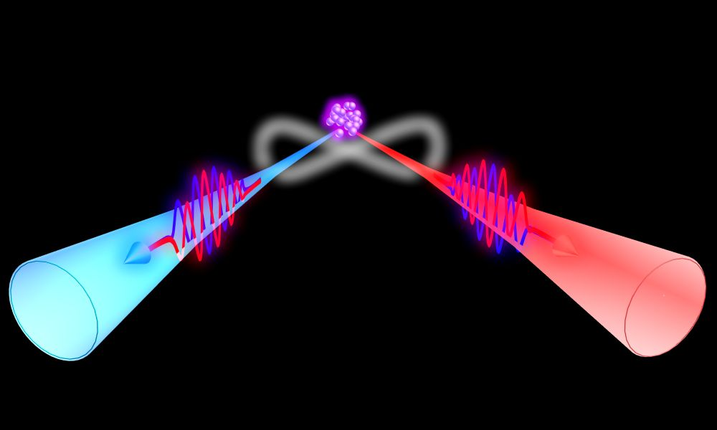
Quantum Entanglement
Entanglement – specially prepared pairs of photons or atoms where the quantum state of each particle is not independent.
  Measurements of physical properties are correlated
  Einstein: “spooky action at a distance”
  Quantum measurement information verified at 10,000x light speed to date.
Quantum Key Distribution with an Entangled Photon Source
Image Credit
Mart Haitjema mart.haitjema@wustl.edu
Opportunities to aid human exploration
  Quantum memories
  Quantum computer network
  Quantum key distribution for secure communication
An Entangled Photon Source
Image credit Physics Department, Hong Kong Science and Technology University

Slide 6
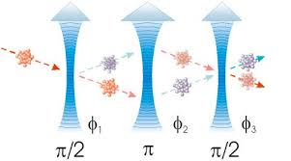
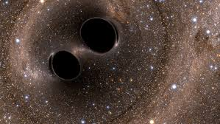
Quantum interferometry and precision measurements
Deep synergy between quantum interferometry and development of high-precision measurement tools.
  Atom interferometers -> precise force measurements [10⁻²¹ m resolution]
  Optical atomic clocks -> precise time measurements [10⁻²¹ fractional frequency]
Enabling technology for gravitational wave detection from 0.01 to 10Hz
  Inaccessible by LIGO and eLISA; White dwarf binary mergers from 0.01 to 0.1Hz, Inflation and Cosmology from 1 – 10 Hz
Enabling technology for ultra-high precision searches for new physics
  Ultra-light Scalar field dark matter detection
  Dark Energy Scalar field detection
Image Credit - Wikipedia

Slide 7
Summary
Acknowledgements
  Funding provided by NASA’s Space Life and Physical Science Research and Applications Division
Resources
  A researcher’s Guide to Fundamental Physics,
  https://www.nasa.gov/connect/ebooks/researchers_guide_fundamental_physics_detail.html
  https://coldatomlab.jpl.nasa.gov/
  https://funphysics.jpl.nasa.gov/ (outdated but illustrative)
Contact Info
  Dr. Ulf Israelsson, 818-354-9255; ulf.israelsson@jpl.nasa.gov

