Slide 1
Combustion Research
Terrestrial and Space Exploration Applications

Slide 2
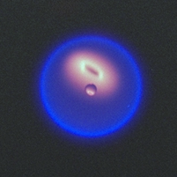
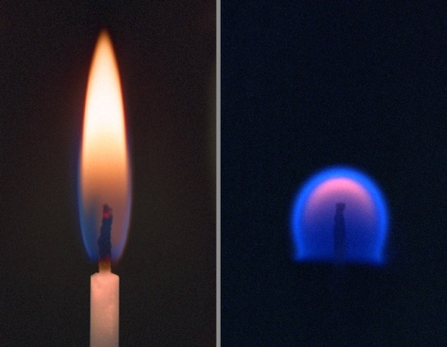
Combustion Background
One of our earliest technologies, yet many details are not completely understood.
Microgravity combustion experiments have been conducted since the beginning of the space program.
Gravity dominates most flames people are familiar with and most laboratory flames and yet does not control most combustor flames.
In space we can gain understanding that can be directly applied to combustion in engines which are typically not controlled by buoyancy.
Near spherical flame around fuel droplet
Candle Flames
1g
0g

Slide 3
Relevance of Space Research in Combustion to Earth Technologies & Space Exploration
To enable critical technologies on Earth. Combustion affects our economy at all levels:
  85% of our delivered energy comes from combustion
  Combustion is the primary source of air pollution and a dominant source of greenhouse gas release
  Unwanted fires cause extensive loss of life and property
To enable human space exploration:
  Fires are a catastrophic hazard in a manned spacecraft
  Low-gravity research is needed to improve and validate fire safety

Slide 4
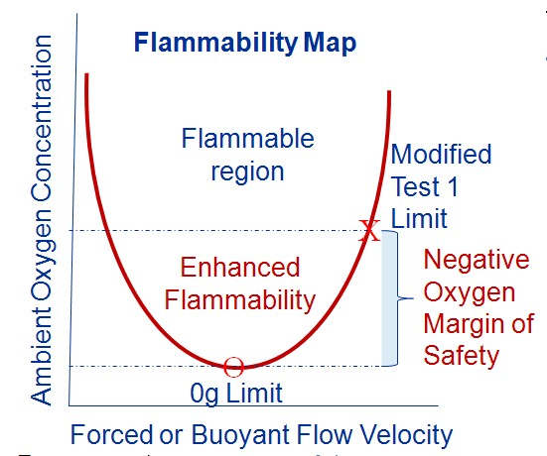
Important Questions – what do we need to know about Combustion to support space exploration?
Buoyant flows induced by combustion heat and 1-g are eliminated in microgravity, changing controlling mechanisms.
The flammability limits of materials can change in low-gravity.
The growth of fires and the transport of smoke in a spacecraft cabin is very different in low-gravity.
Quenching
Blowoff

Slide 5
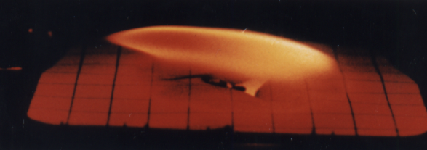
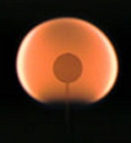
What have we learned about Combustion that can only be revealed in the spaceflight environment?
  Cool Flames were stabilized in low-gravity unexpectedly, providing a test of the chemical kinetics for engine knock and diesel ignition.
  Radiative Extinction: the absence of buoyant flow made radiative heat loss the dominant mechanism for extinction.
  Flame Balls were believed to be possible in the absence of buoyancy. They were predicted to exist 70 years ago but had never been demonstrated until the space experiments.
  Fire Risk exists in spacecraft as long as there is fuel, oxygen, and a potential source of heat.
Hot flame
Cool flame
Flame spread into the wind in low-gravity
Spherical Flame

Slide 6
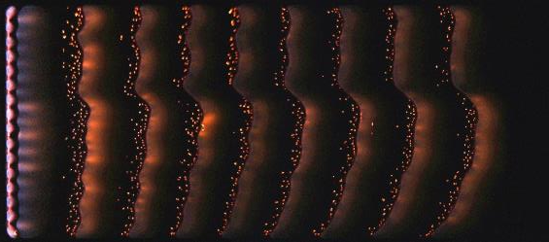
Pitfalls & Lessons Learned
Extended residence times and spatial scales enable radiative cooling to be much more significant than in buoyant flames.
Ground-based facility testing is not fully indicative of behavior in long-term microgravity (g-jitter for fluid handling, stabilization time for flow and flow system; establishment of full thermal field).
The expanded spatial scale of the flame leads to a greater influence of the chamber than in 1-g.
Enhanced models needed for interpretations
Not surprisingly, fire raises design challenges that constrain the experiments that can be safely executed
Multiple images from large scale flame spread
Pool fires
Flameballs

Slide 7
Acknowledgments
  Funding provided by NASA’s Space Life and Physical Science Research and Applications Division
Resources
  A Researcher’s Guide to Combustion Science: https://www.nasa.gov/connect/ebooks/researchers_guide_combustion_science_detail.html
  Physical Science Research Program at NASA Glenn Research Center
  http://spaceflightsystems.grc.nasa.gov/sopo/ihho/psrp/
  Microgravity Combustion: Fire in Free Fall Edited by Howard D. Ross, Academic Press, 2001.
  contact Info: David Urban, (216)433-2835, david.urban@nasa.gov

