Slide 1
Space Science 101:
Fluid Physics & Complex Fluids
John McQuillen
Low-Gravity Exploration Technology Branch
NASA Glenn Research Center
Cleveland, Ohio 44135

Slide 2
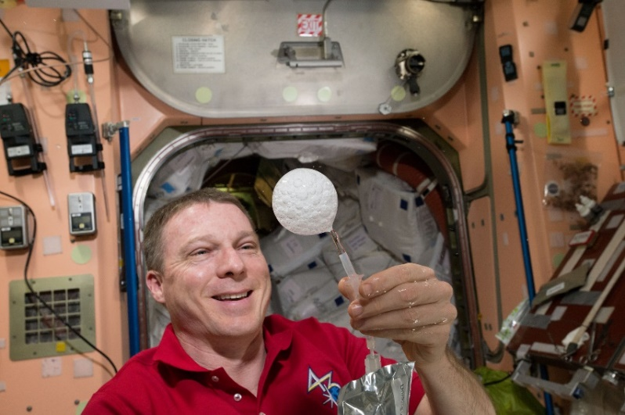
Overview of Fluids Physics and Complex Fluids
“Settling” does not occur among heavier and lighter objects or phases minimizing compaction.
Elimination of hydrostatic pressure effects.
Droplets do not sag under their own weight and bubbles are not squashed by the surrounding liquid.
Behavior becomes 3-dimensional as opposed to planar
Flows tend to be unidirectional.

Slide 3
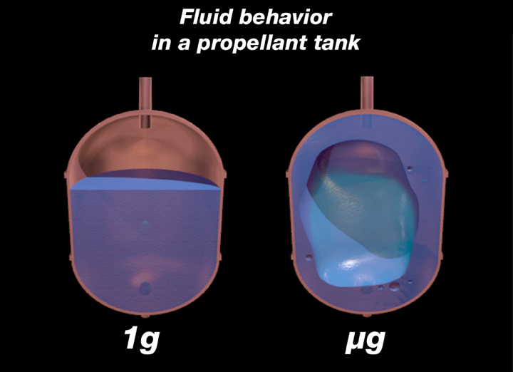
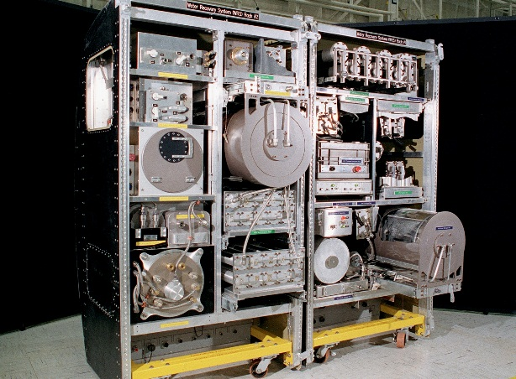
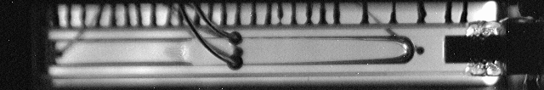
Relevance of Space Research in Fluids Physics and Complex Fluids to Earth & Space Exploration
Life support systems.
Fluid Management.
TEMPERATURE Control and Heat Removal.

Slide 4
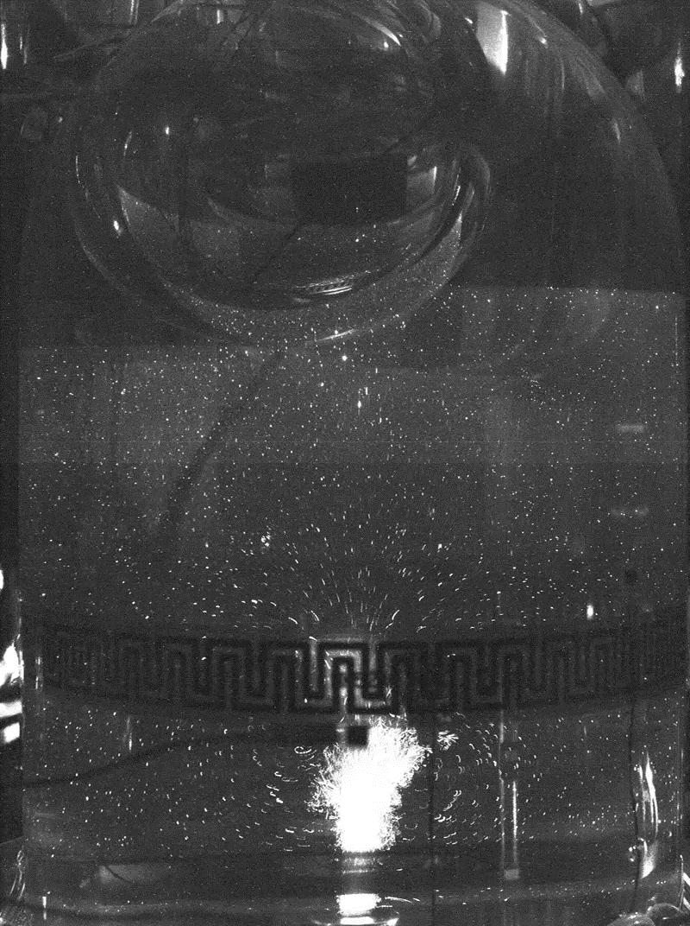
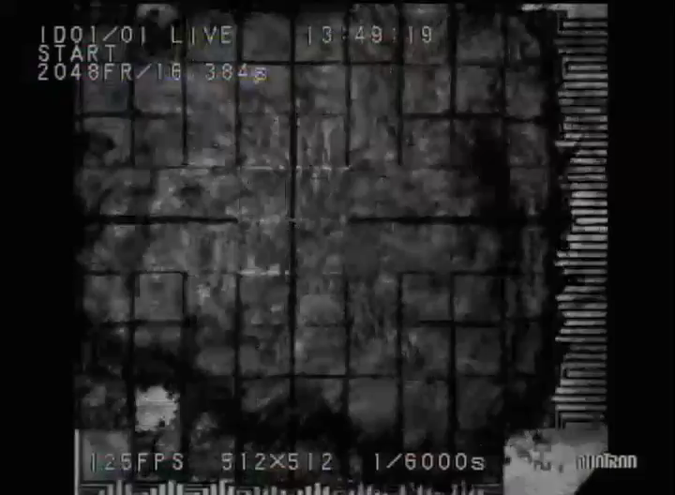
Important Questions – what do we need to know about Fluids Physics and Complex Fluids to support space exploration?
Phase Change:
Mixing:
Separations:
System Stability:

Slide 5
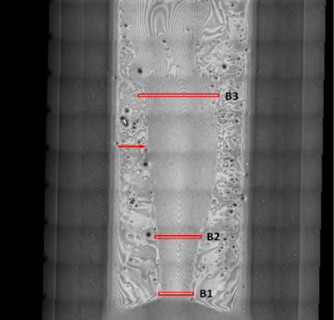
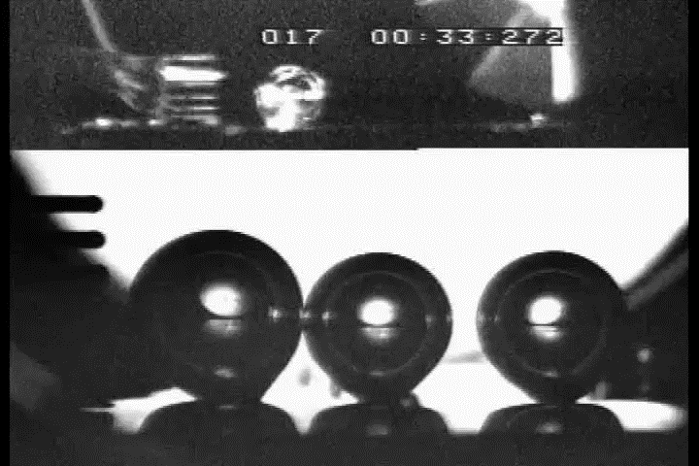
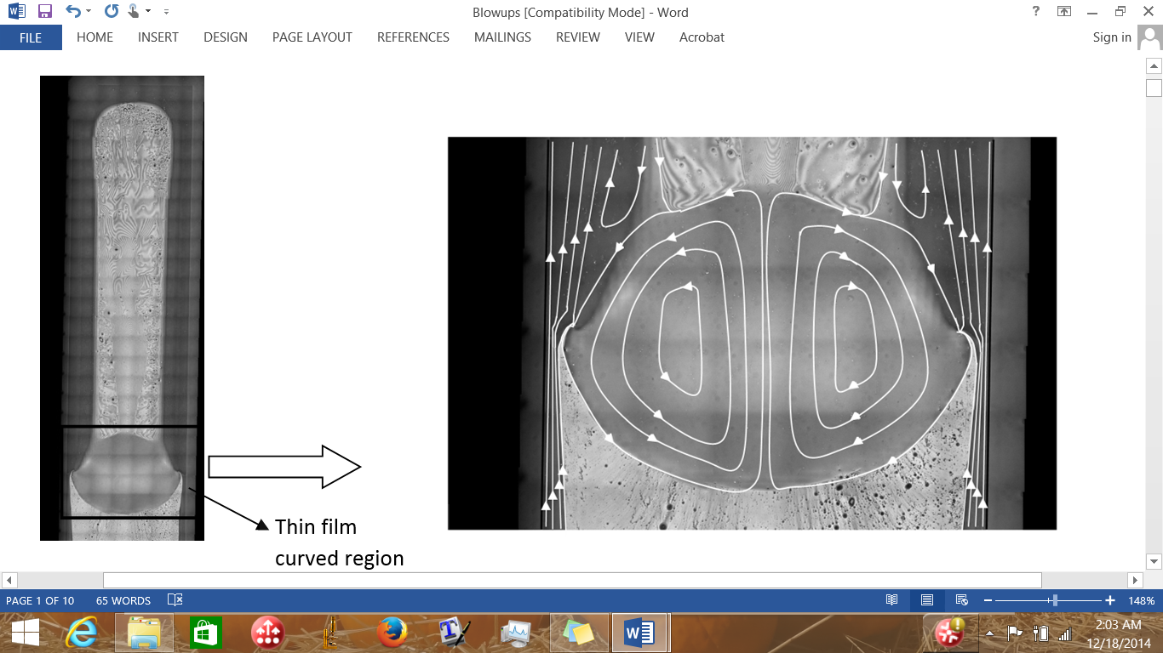
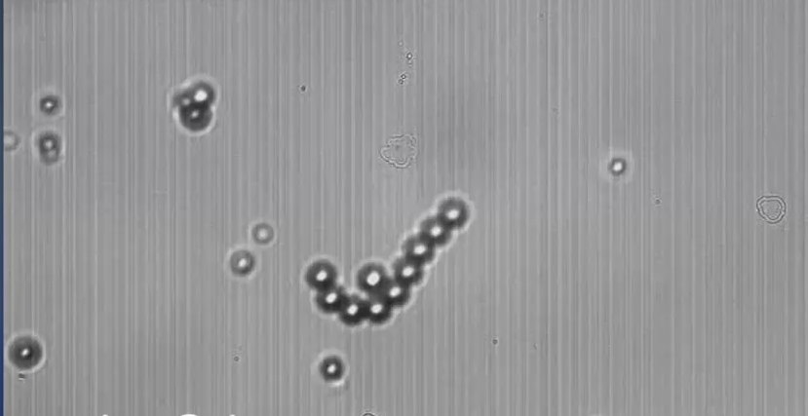
What have we learned about Fluids Physics and Complex Fluids that can only be revealed in the spaceflight environment?
Rip currents form at high heat loads due to spinning within the liquid drop and need to dissipate the heat.
Evaporation occurs along the edges of the current and boundaries of the drop.
Bubble Coalescence:.
Capillary Behavior
Colloidal Self-Assembly
Rip
Current
Flooded
Heater
Input Power
3 W
Surface Tension
Flow
Liquid
Drop
Capillary
Flow
Surface tension driven flow opposes the capillary return flow and leads to a flooding limitation in the heat pipe.

Slide 6
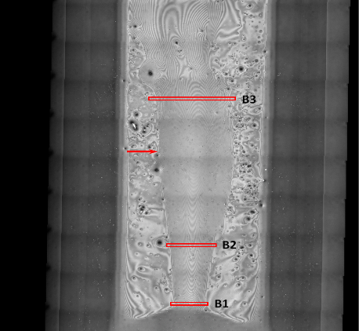
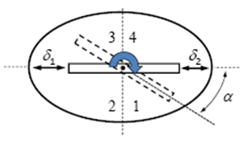
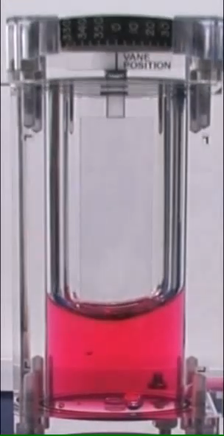
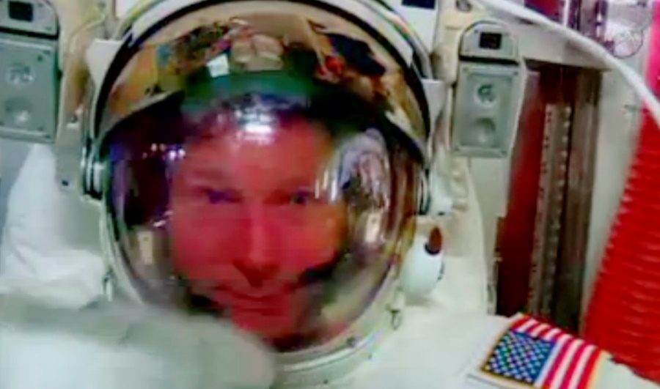
Pitfalls & Lessons Learned
Rip currents form at high heat loads due to spinning within the liquid drop and need to dissipate the heat.
Evaporation occurs along the edges of the current and boundaries of the drop.
Capillary Behavior:.
Vapor Condensation:
Rip
Current
Flooded
Heater
Input Power
3 W
Surface Tension
Flow
Liquid
Drop
Capillary
Flow
Surface tension driven flow opposes the capillary return flow and leads to a flooding limitation in the heat pipe.

Slide 7
Etc.,
Acknowledgements:
  Funding provided by NASA’s Space Life and Physical Science Research and Applications Division
Resources
  A Researcher’s Guide to Fluid Physics: https://www.nasa.gov/sites/default/files/atoms/files/np-2015-10-033-jsc_fluid_physics-022416-508c_1.pdf
  Physical Science Research Program at NASA Glenn Research Center
  http://spaceflightsystems.grc.nasa.gov/sopo/ihho/psrp/
Contact Info: John McQuillen, (216)433-2876, John.B.Mcquillen@nasa.gov

