Slide 1
Overview of Materials Science & Biophysics Research From The SLPSRA Program at MSFC
Jan Rogers
Michael SanSoucie
Pam Twigg
Shawn Reagan

Slide 2
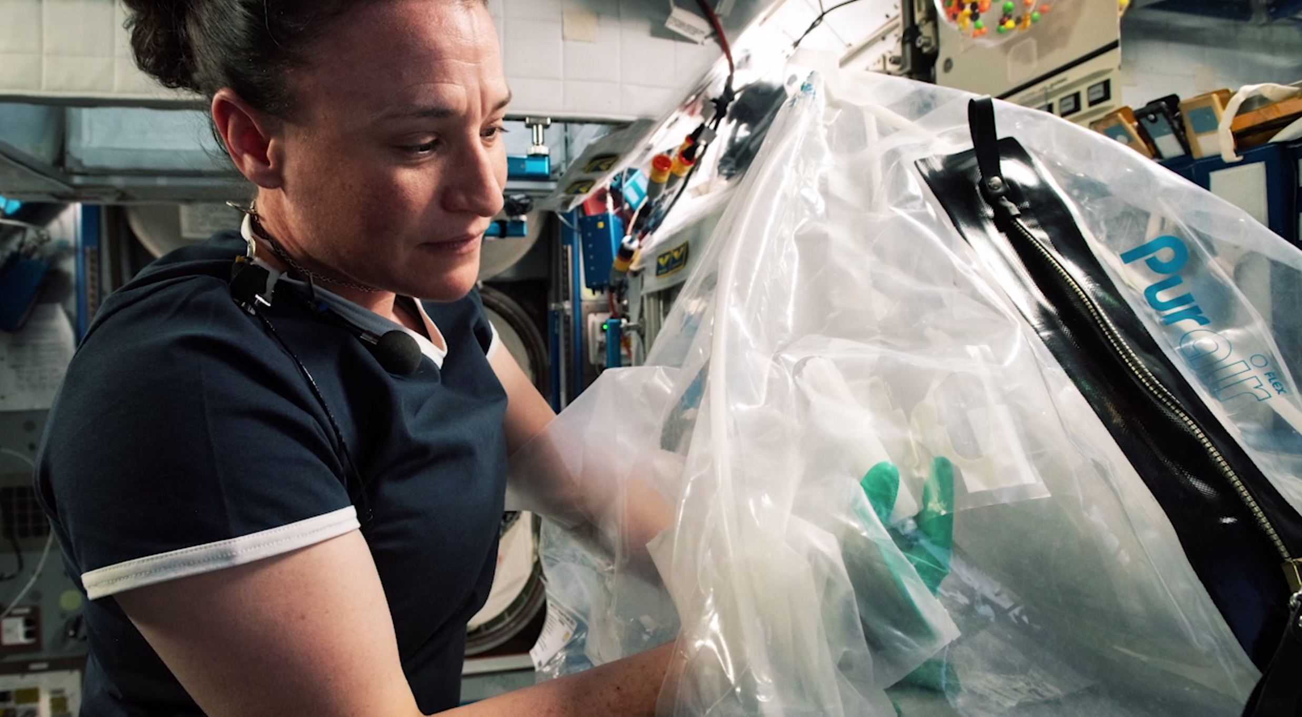
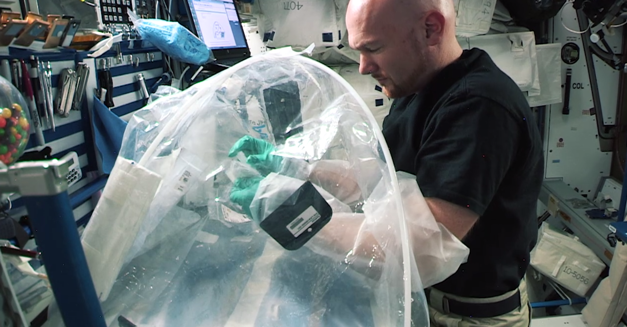
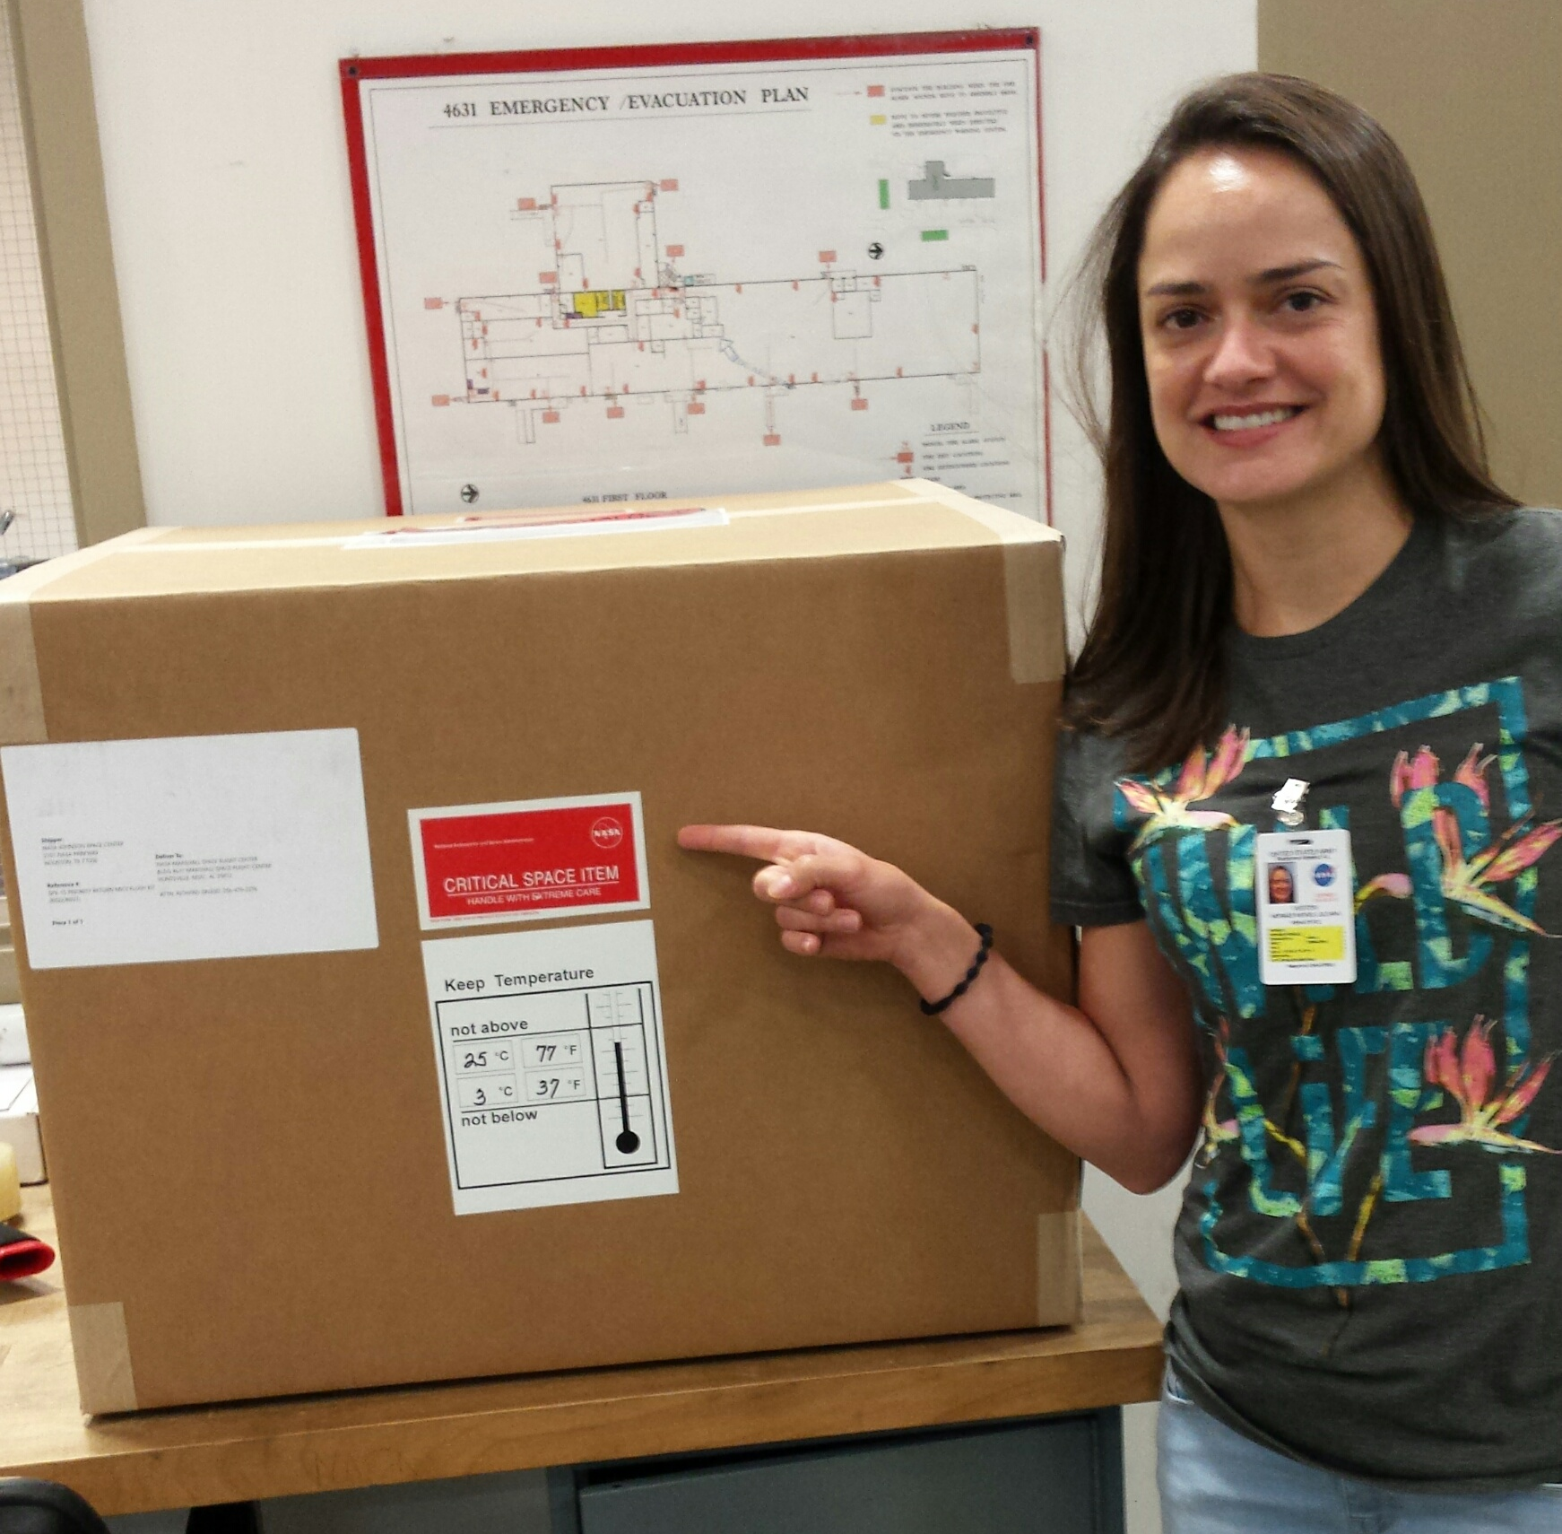
Why Microgravity
Microgravity Investigation of Cement Solidification (MICS)
Dr. Aleksandra Radlińska, Penn State
The International Space Station (ISS) provides a long-duration spaceflight environment for conducting microgravity experiments
The microgravity environment greatly reduces buoyancy-driven convection, pressure head and sedimentation in fluids.
Penn State doctoral candidate Juliana Neves with box containing MICS samples returned from the ISS

Slide 3
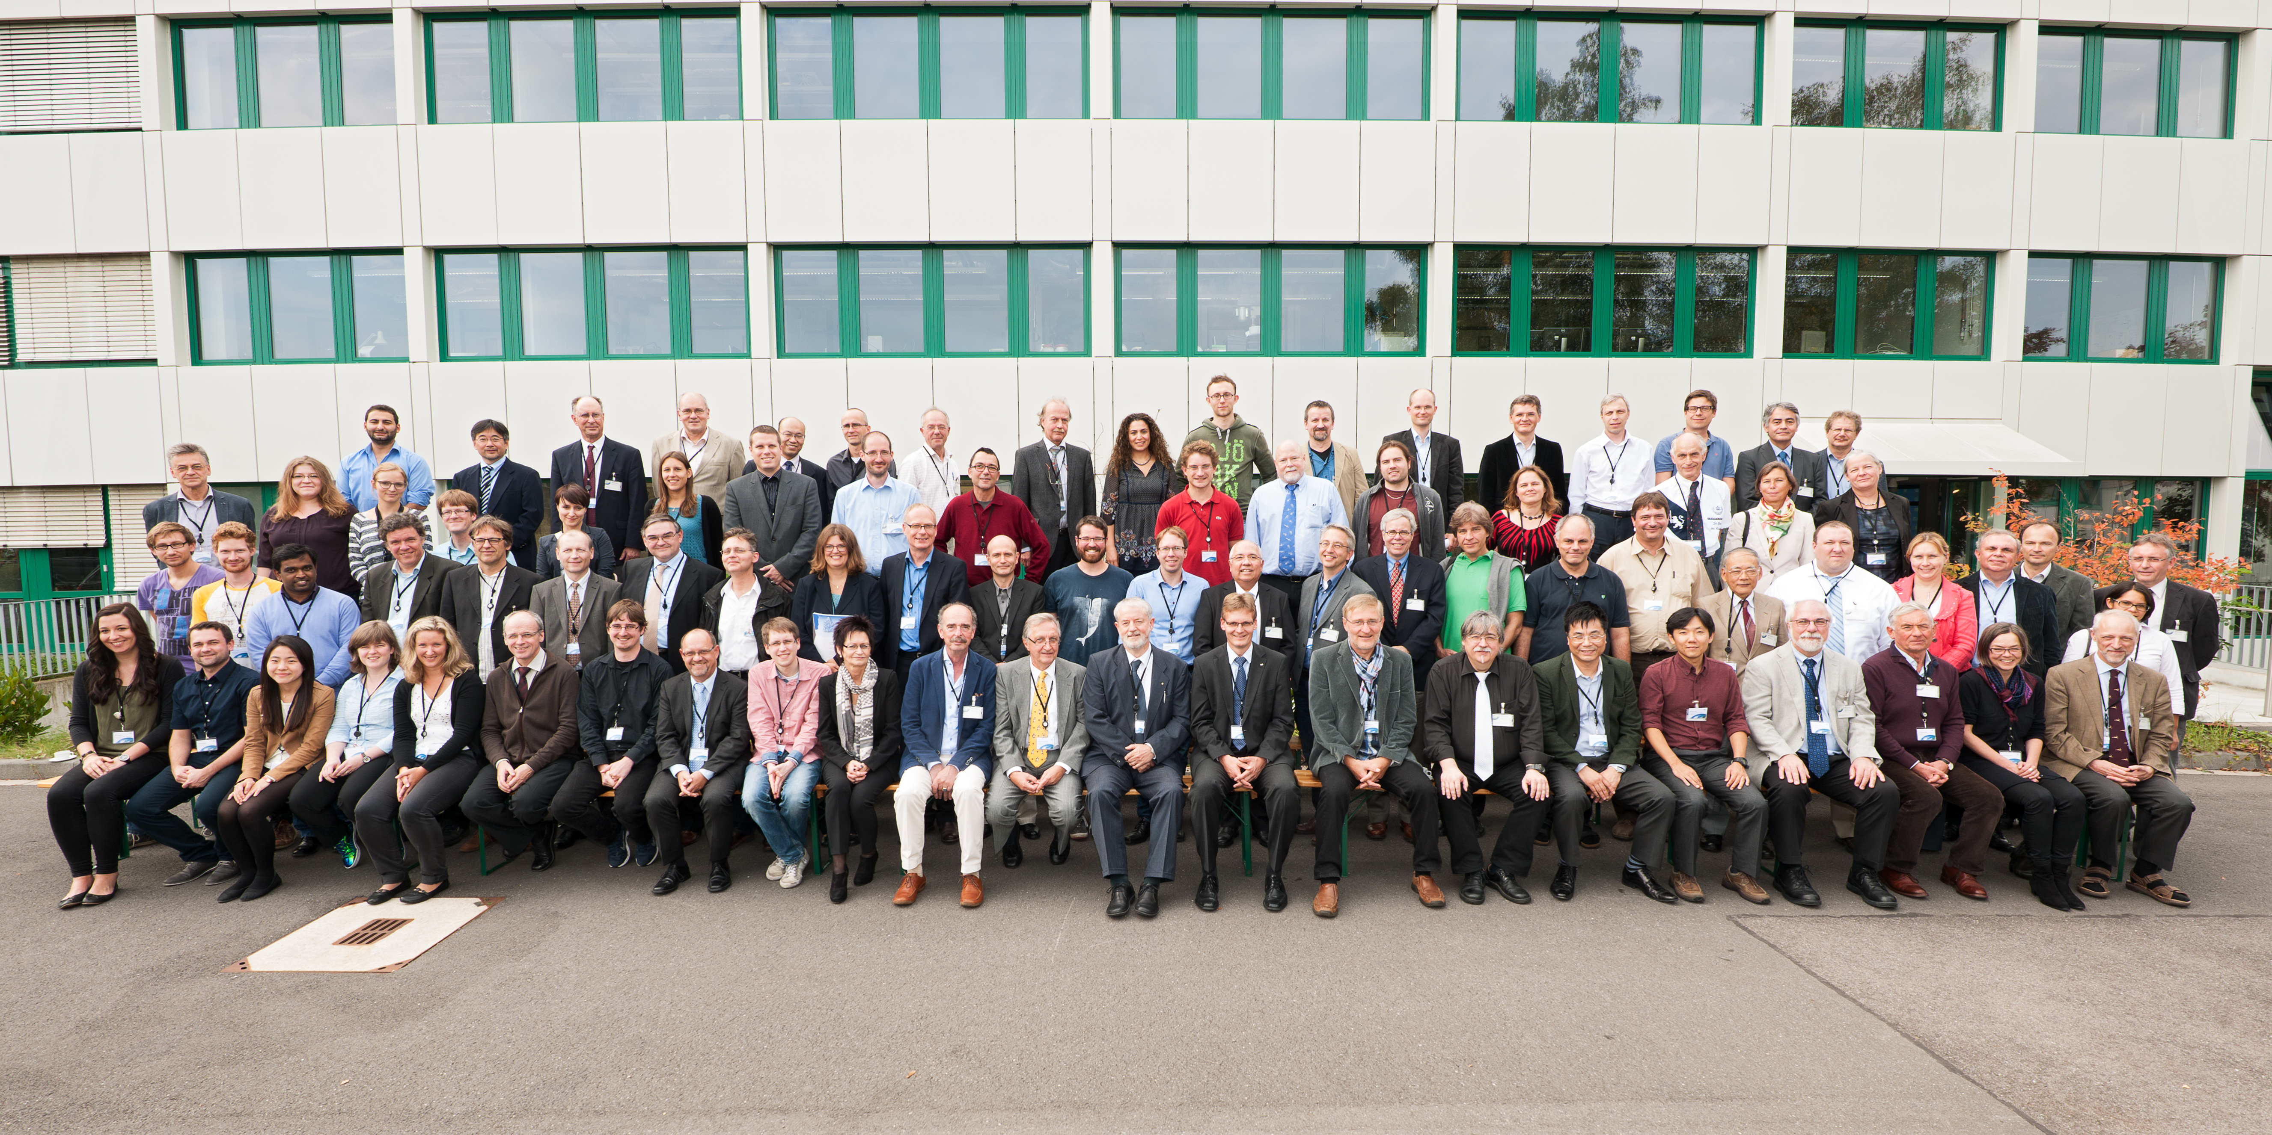
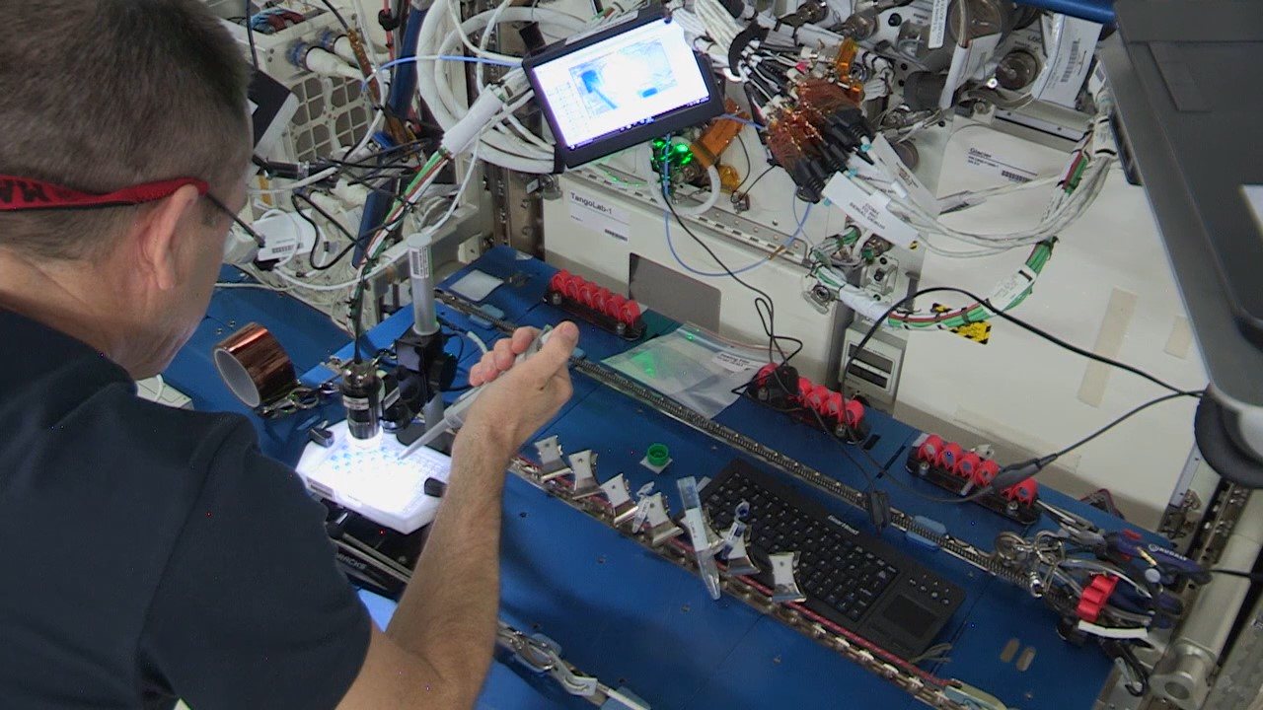
Microgravity Materials Science Community
More than 40 current Grants and activities
International Partners including:
International collaborators including:
Austria
Belgium
Canada
Germany
Japan
Russia
South Korea
Group photo during an ISS-EML International Working Group (IWG) meeting in Cologne, Germany
An Astronaut performing protein crystal growth experiments on the ISS.

Slide 4
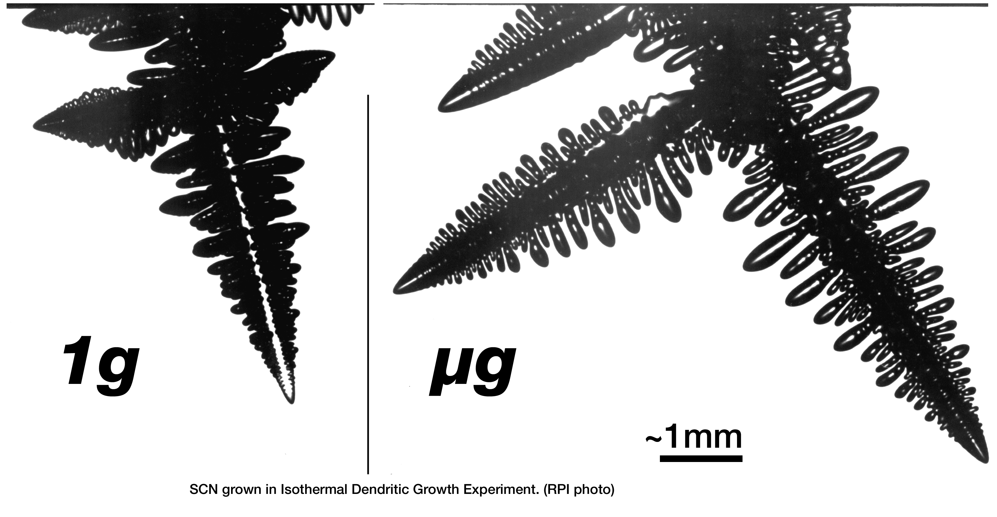
Materials Science Research
A large variety of Materials Science research is either ongoing or planned on ISS
Metals & Semiconductors research
Isothermal Processes
Current Experiments: GEDS, FAMIS, DECLIC DSI
Directional Solidification
Current Experiments: SETA, CETSOL
Crystal Formation
Current Experiment: GTS
Solidificaton Microstructure, Cement, Brazing and Freeze Casting Reference Experiments
Thermophysical Properties research
ESA Electromagnetic levitation (ISS-EML)
JAXA Electrostatic Levitation Furnace (ELF)
Low to near zero fluid flow in levitated samples in microgravity
Measurements of density, specific heat, surface tension, and viscosity
On metals, semiconductors, oxides, and glasses
Current ISS-EML experiments: ELFSTONE, ICOPROSOL, PARSEC, THERMOLAB, QUASI
Current ELF experiment: Modeling and Simulation of Electrostatically Levitated Multiphase Liquid Drops
Goal: measure the interfacial tension between molten iron and slag. The results of the project could help with more efficient production of higher quality steel
Planned ELF experiment: MaterialsLab Thermophysical Properties Reference Experiment
Dendrites grown in Isothermal Dendritic Growth Experiment (IDGE).
ISS-EML image of molten iron-chromium-nickel steel casting alloy showing solidification of primary ferrite and subsequent conversion to secondary austenite.

Slide 5
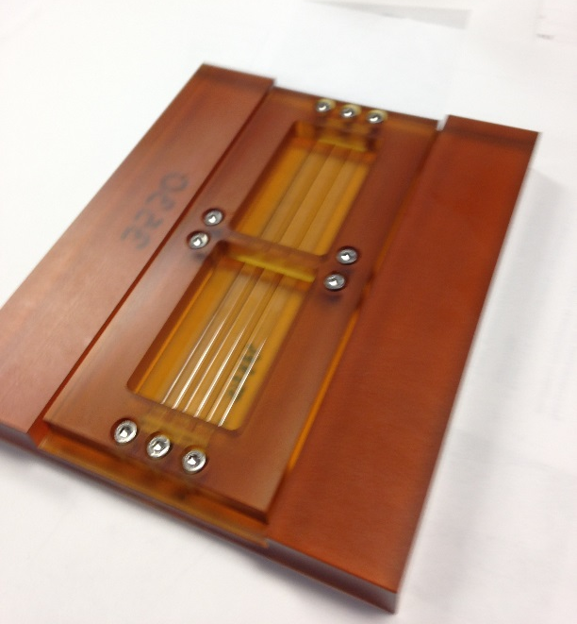
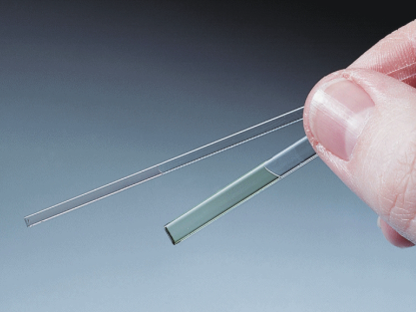
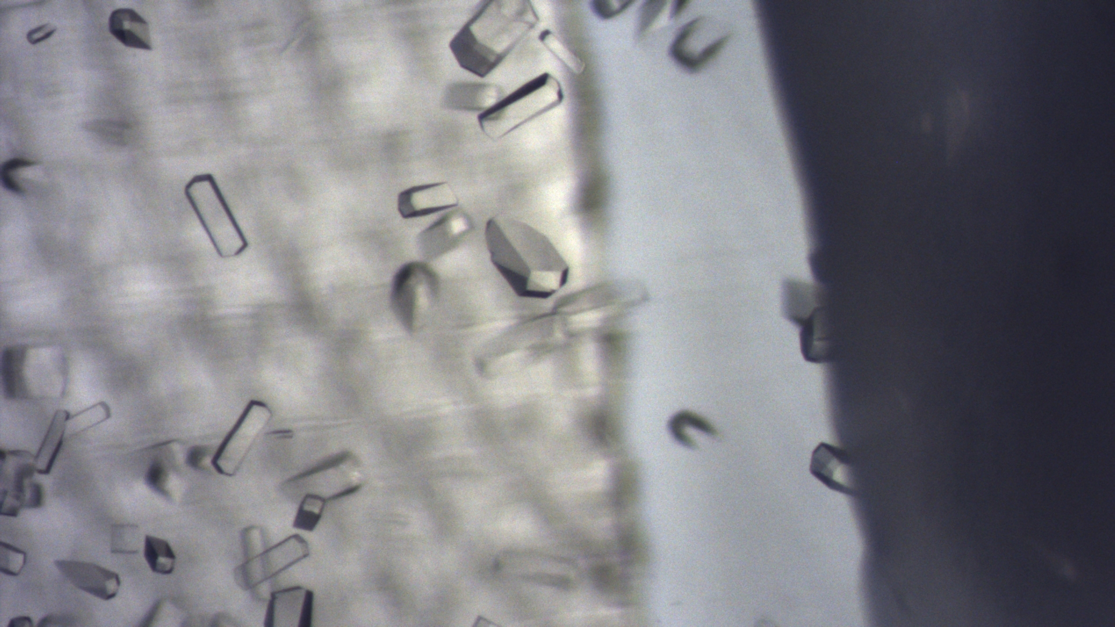
Biophysics Research
An example of biophysics research is protein crystal growth (PCG).
Microgravity missions have shown that crystals of some proteins (and other complex biological molecules such as viruses) grown on orbit are larger and have fewer defects than those grown on Earth.
PCG hardware used in space.
The improved data from the space-grown crystals significantly enhance scientists’ understanding of the protein’s structure and this information can be used to support structure-based drug design.
Lysozyme crystals grown on ISS during ops in July 2018/ Returned on SpaceX-15.

Slide 6
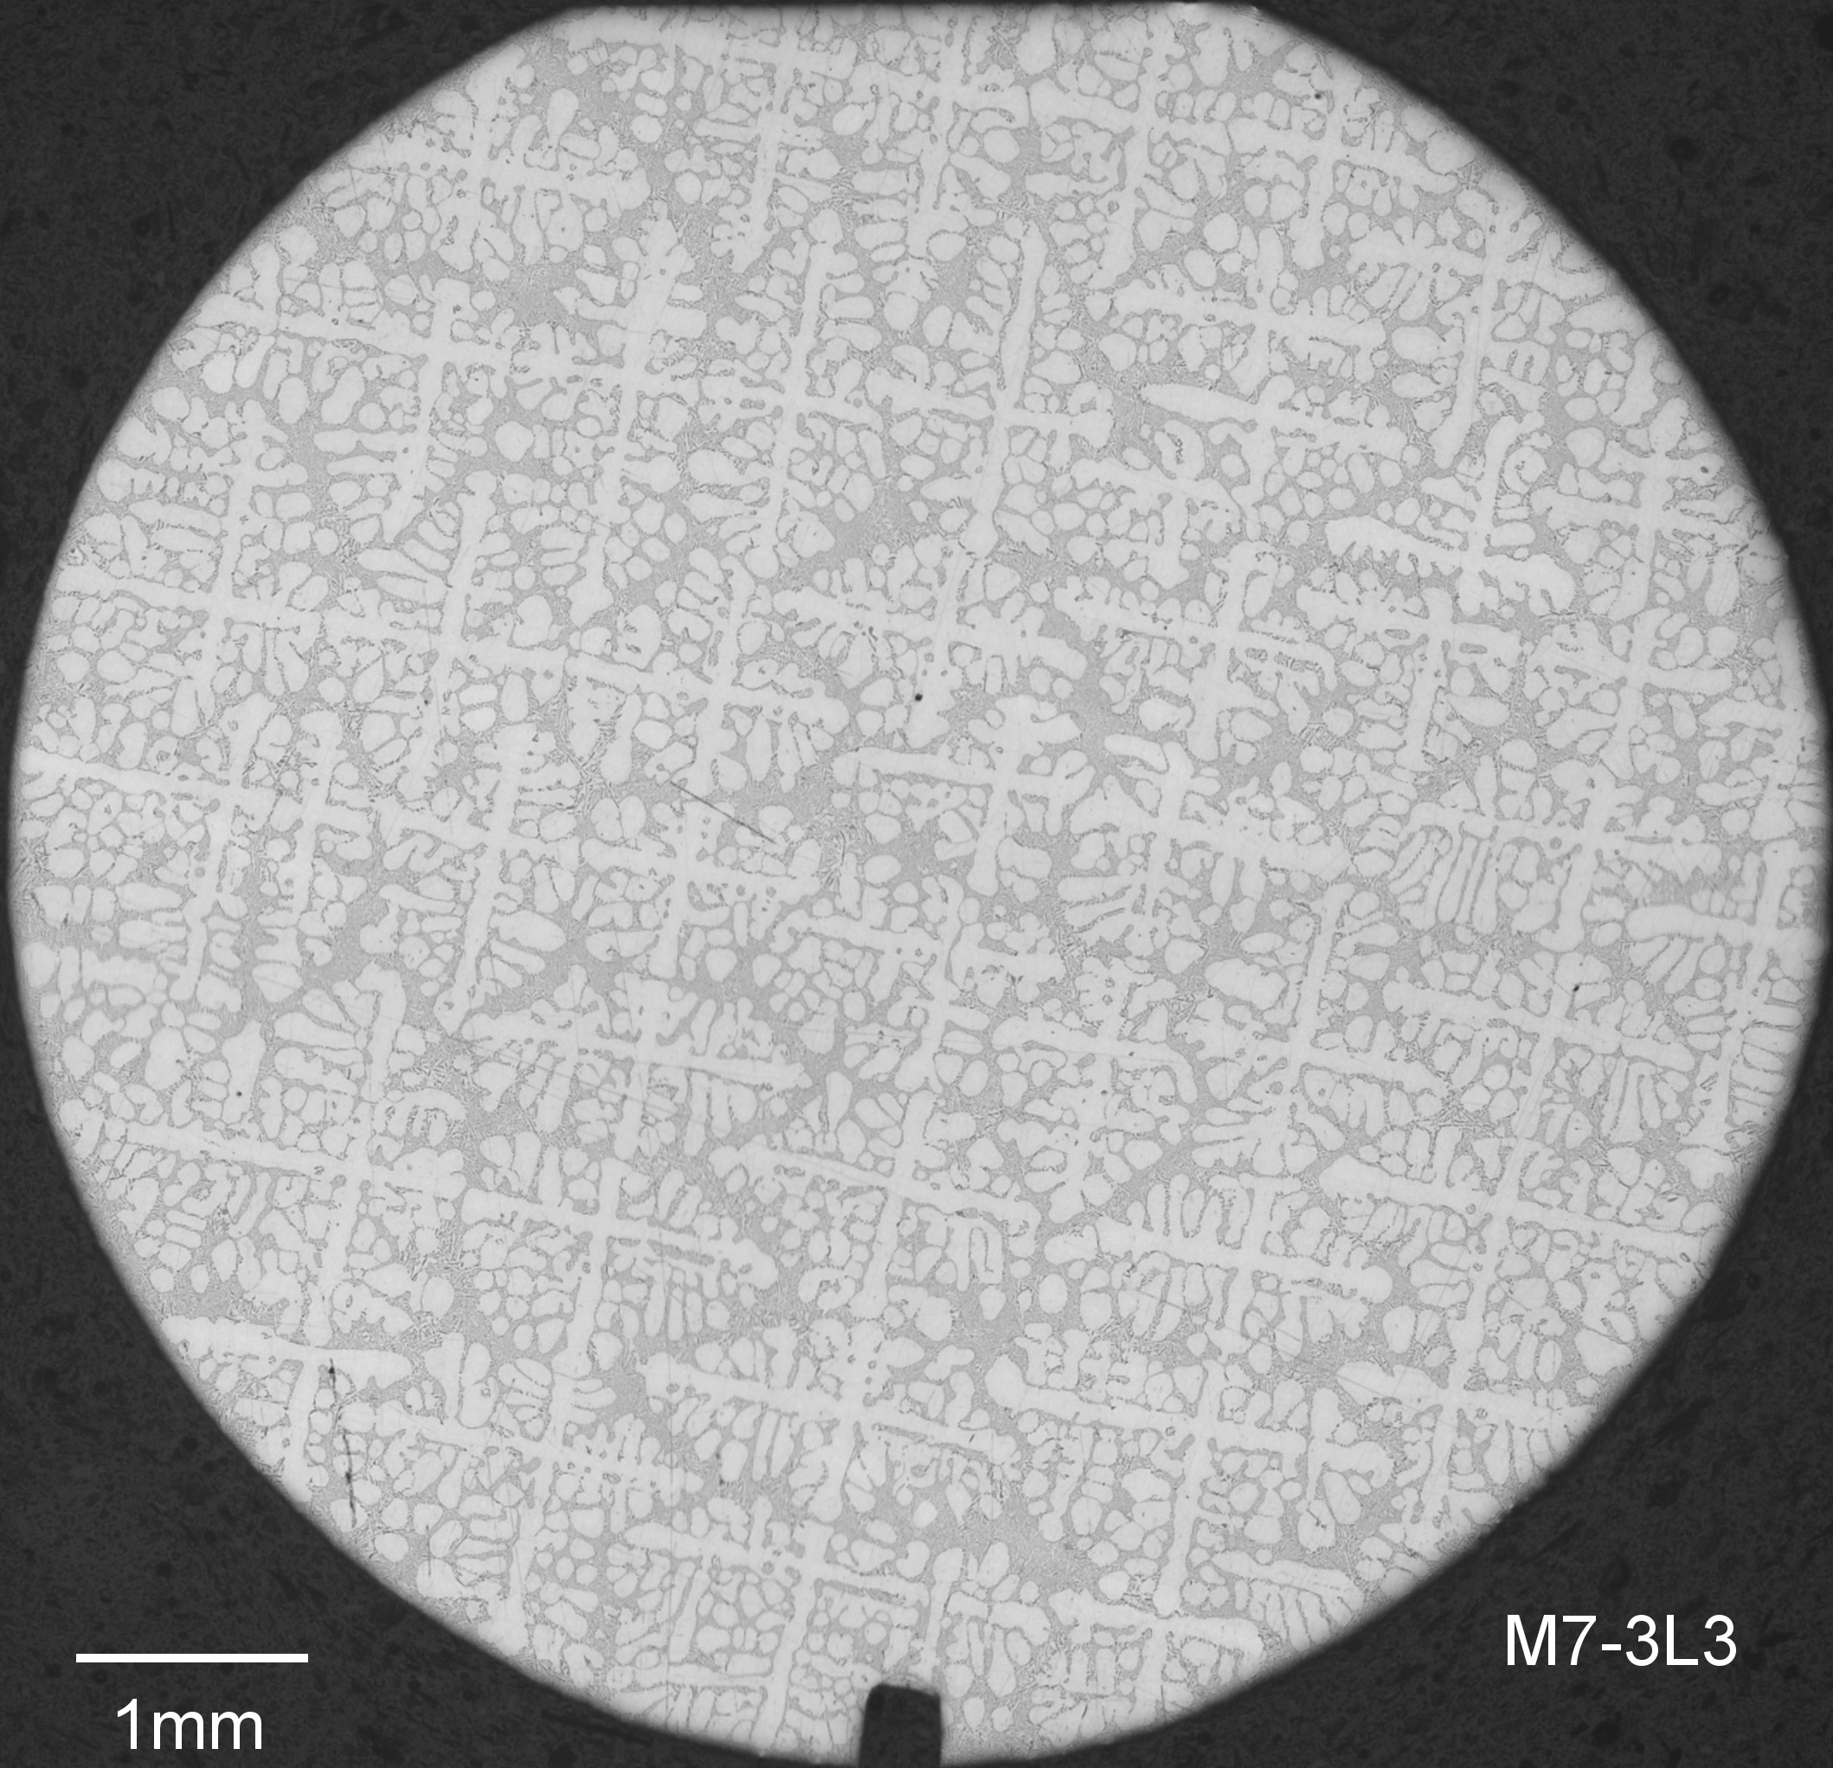
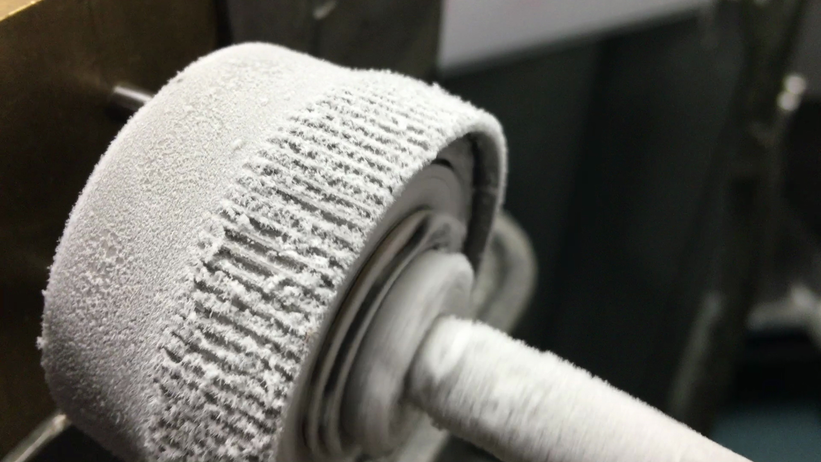
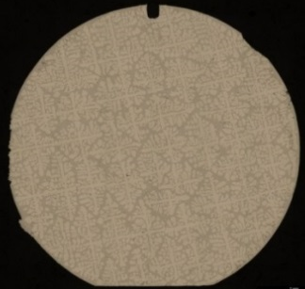
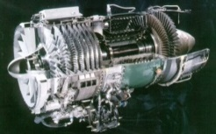
Exploration & Earth Benefits From Research
Our materials research programs study materials with these applications:
Semiconductors
Welding
Casting
Alloy development
Glass processing
New materials for optical devices, lasers, and photonics
New materials needed for extreme environments (i.e. space or celestial surfaces)
Our PCG research efforts are focused on understanding:
The physics of improved protein crystal quality in microgravity
Establishing protocols for setting up and optimizing crystallization experiments on ISS.
High quality crystals can be used to help develop new pharmaceuticals.
Bulk Metallic Glasses (BMG’s) are a new class of materials being studied on ISS. These materials have many exciting properties, for example they do not get brittle in extreme cold.
An aluminum-7wt% silicon sample directionally solidified on the ISS. The applications of this science are solidification castings that are used in gas turbine “jet” engines.
Microgravity solidified Al-7% Si alloy shows a uniform dendritic network
Apply Microgravity
Gained Knowledge
Higher Temperature
Greater Efficiency
Longer Life

Slide 7
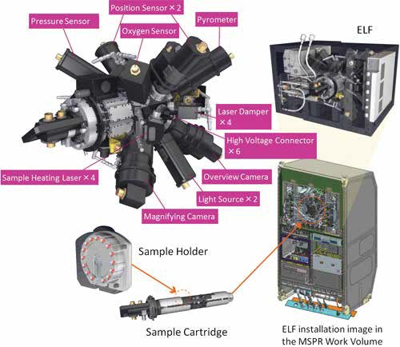
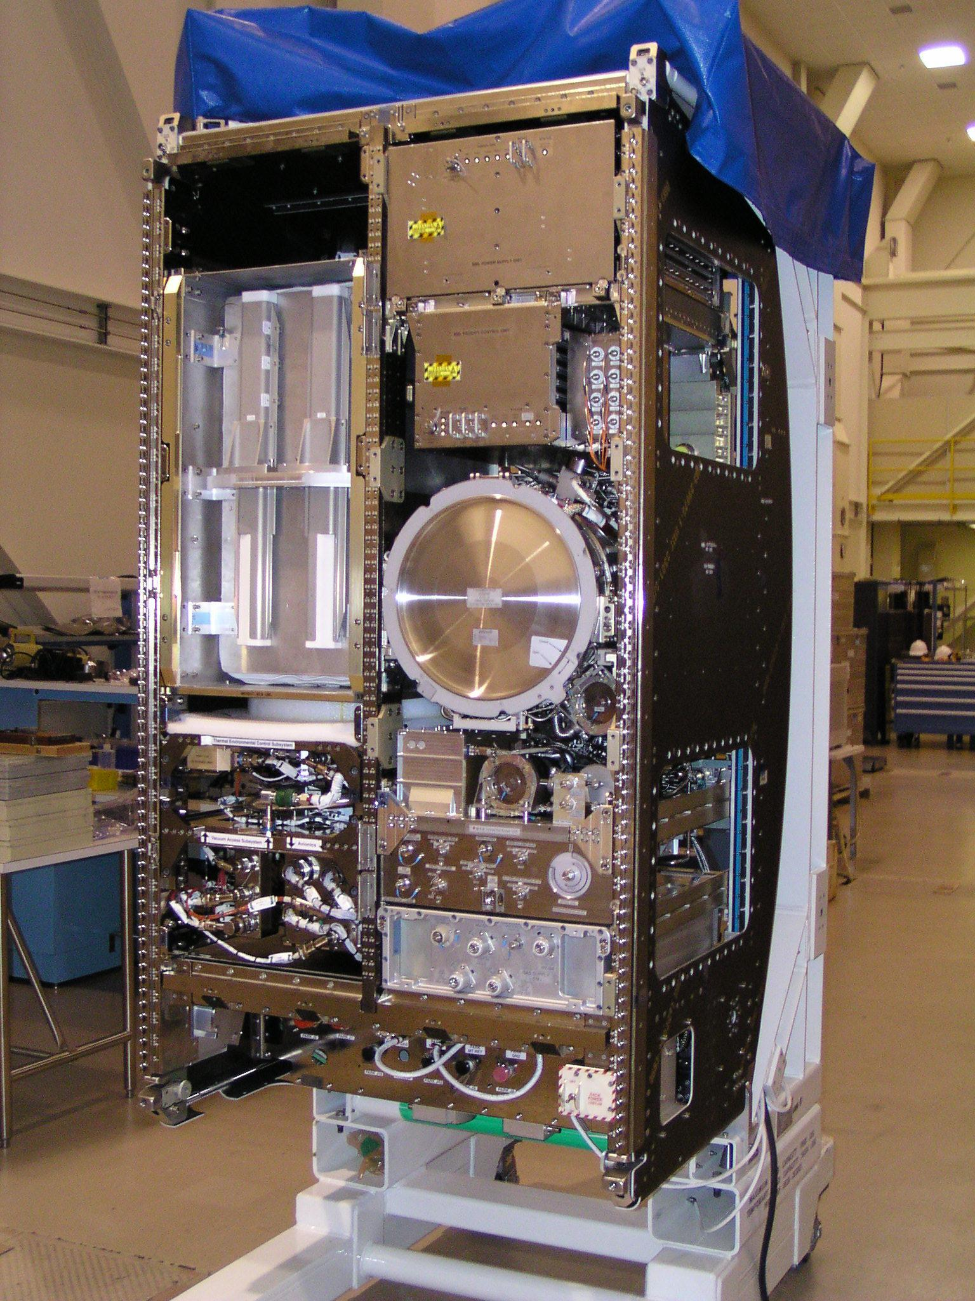
Summary
Ongoing and near-term operations on ISS including:
ESA ISS-EML
JAXA ELF
MSRR
Glovebox
SUBSA
CNES DECLIC
PCG & Biofilms
Future
SLPSRA is planning a joint Materials Science Workshop with CASIS at the ISS R&D conference in Atlanta, July 29 – August 1, 2019. Workshop details TBD.
We anticipate developing a new NASA Research Announcement (NRA)
Acknowledgment: NASA Space Life and Physical Sciences Research and Applications (SLPSRA)
Electrostatic Levitation Furnace (ELF)
Materials Science Research Rack (MSRR) ground unit.

