Slide 1
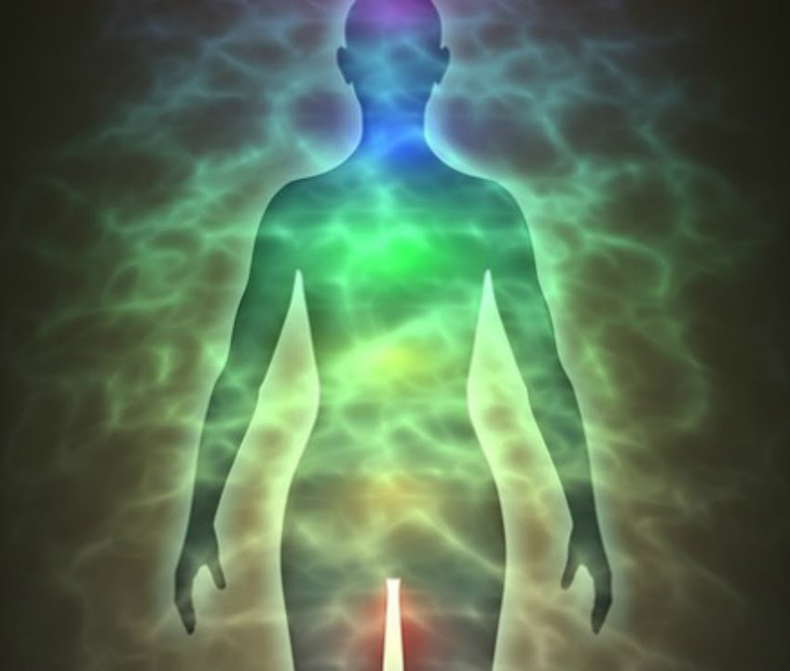
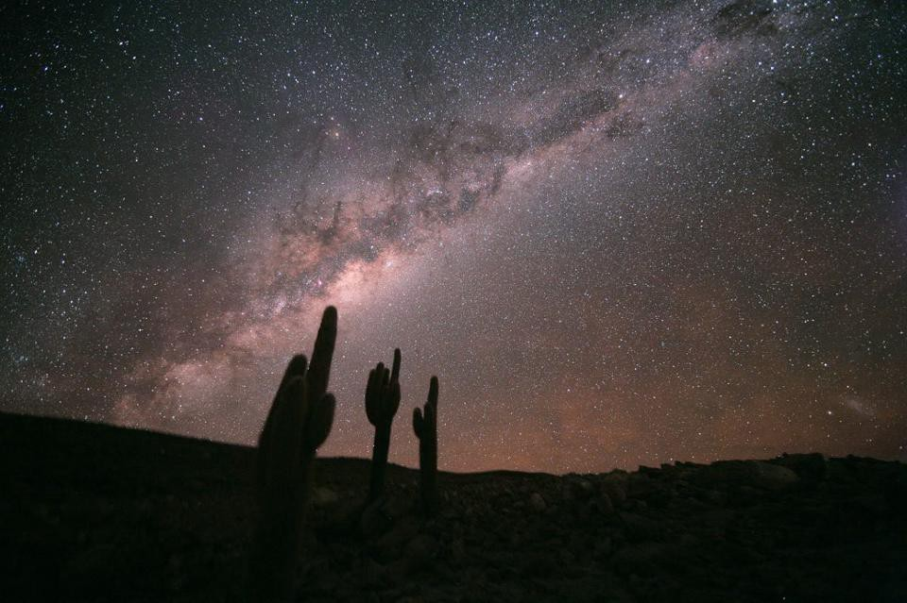
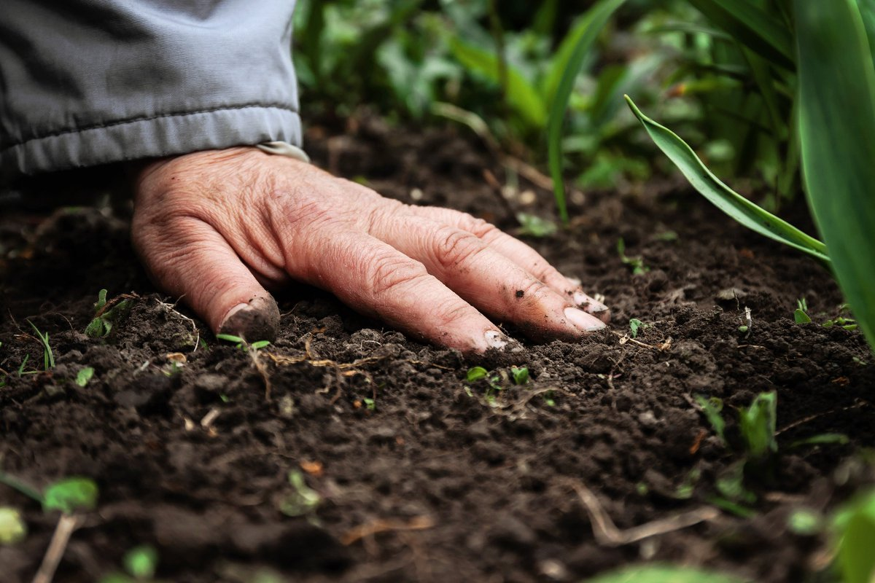
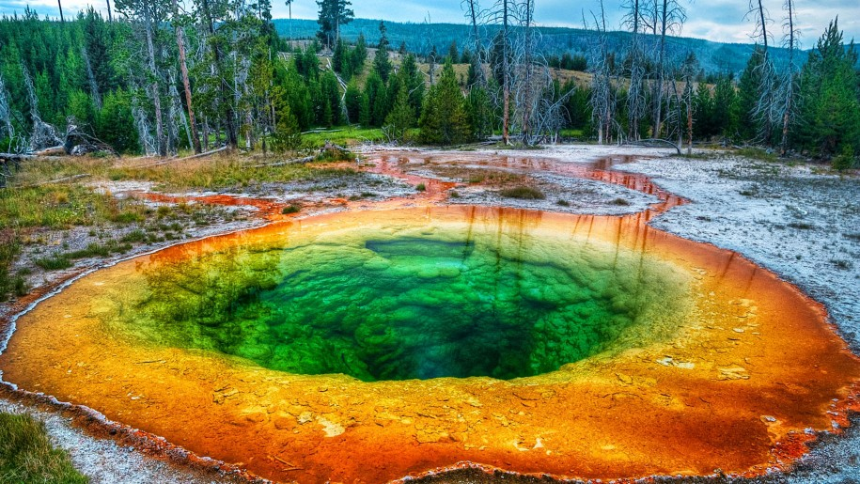
Space 101 : Microbes
“Microbes maketh man”
Jamie Foster – University of Florida
Microbes play a vital role in maintaining:
Human health
Agriculture
Nutrient cycling
Environmental remediation
Where ever humans go we bring microbes with us!
Notes:
If you don’t like microbes you are on the wrong planet.
We live in a microbial zoo – we literally leave a cloud of microbes where ever we go
Petri dishes in shoes!

Slide 2
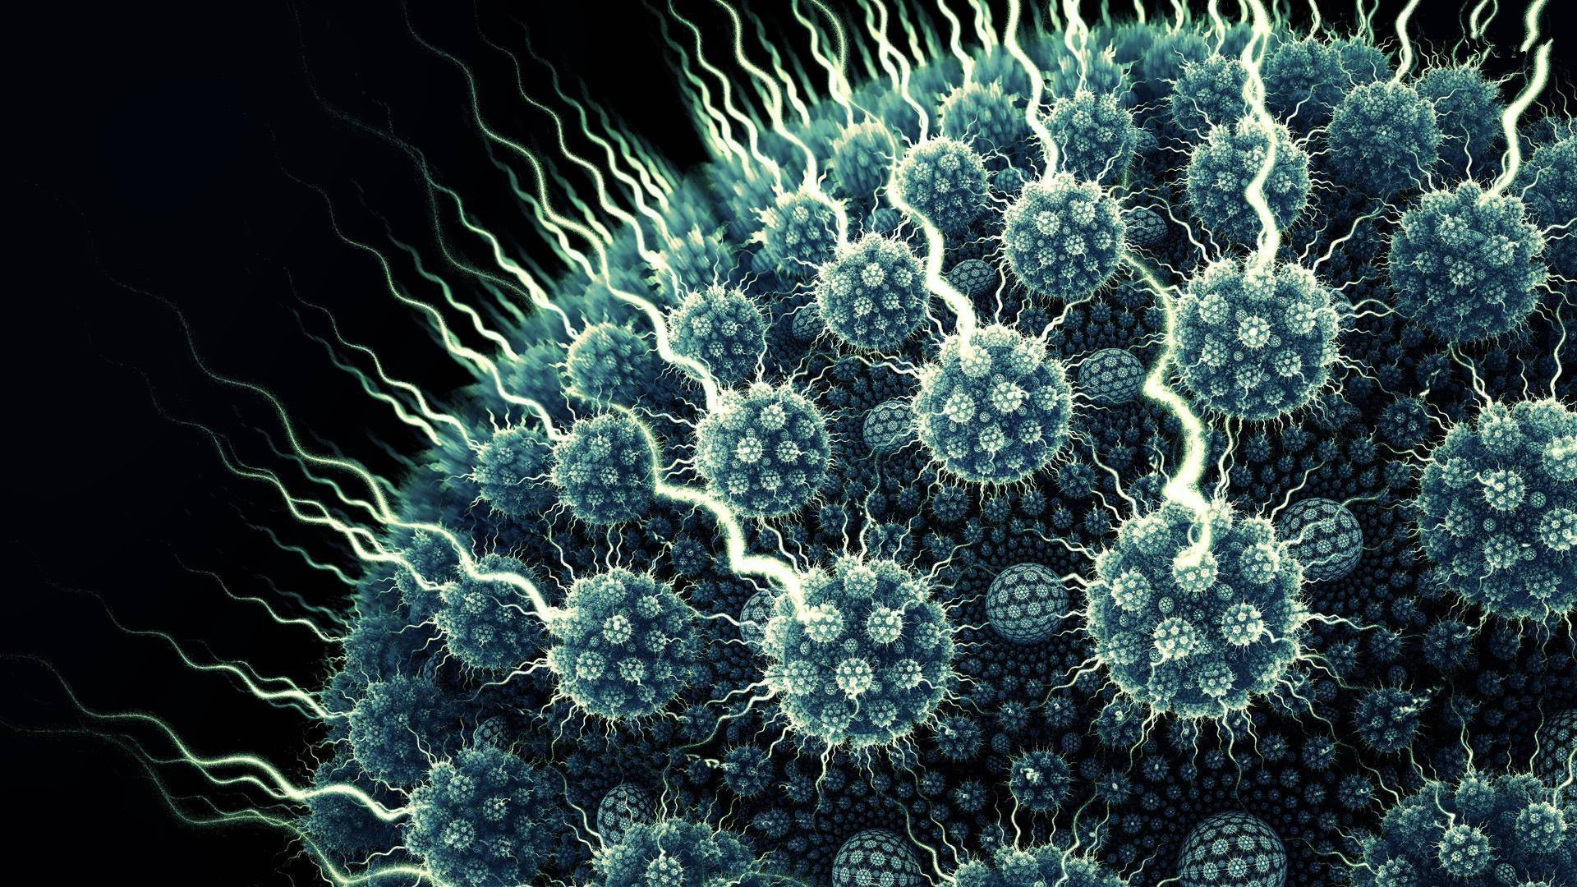
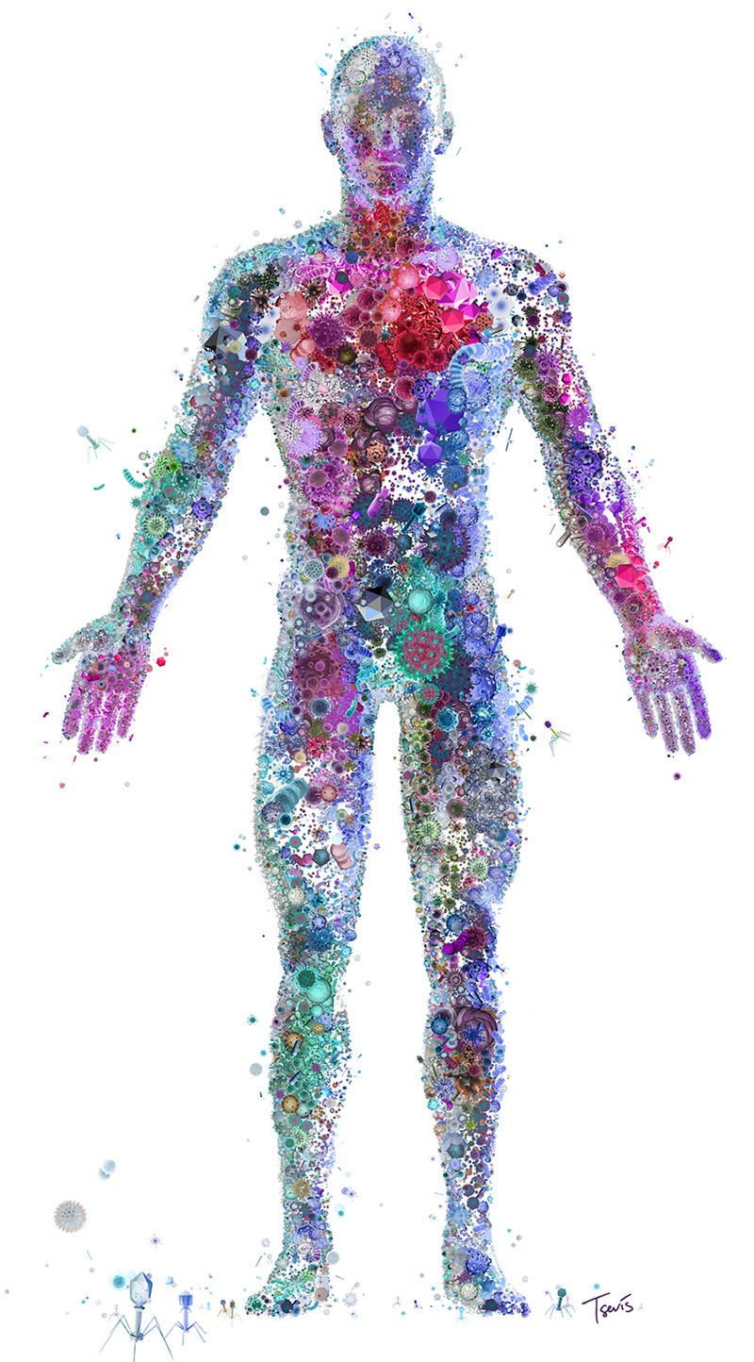
Space 101 : Microbes
Why is the study of microbes important to Space Research?
Microbes are essential for human-led space exploration!
Microbes help with digestion, immune system development, and influence nervous system
Disturbances in microbiome can lead to disease
Environmental microbes can be used in advanced life support and facilitate agriculture for extended space exploration
Therefore, it is critical to understand how microbes are impacted by the space environment.
Notes:
The human body has more microbial cells that there are stars in the milky way galaxy
5:1 ratio of viruses to bacteria
150:1 – ratio of bacterial genes to your human genes
1.3X

Slide 3
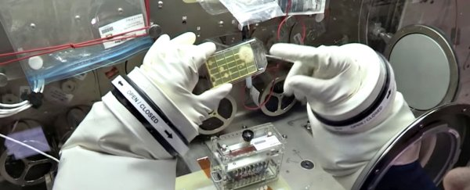
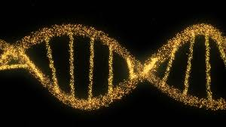
Space 101 : Microbes
Why is microbiology-based Space Research important to Earth?
Gravity may be obscuring key pathways and processes of how microbes interact with themselves or host
Insights into how microbes are altered under the stress conditions associated with spaceflight might help develop treatments for microbiome-related disorders here on Earth.
Efforts to study the role of microbes in biodeterioration of spacecraft materials may help improve the development of more durable materials for use on Earth.
Research on the mechanisms by which microbes remediate and detoxify compounds in Biological Life Support Systems could be used to improve waste recycling efforts on Earth.
The study of microbial communities aboard spacecraft may identify new biological products that could be of value to the development of new medicines or therapies.
By removing the impact of gravity on microbes, we can gain new insight into the physiology, metabolism, genetics and interactions of microbes.
Notes:
Insights into how microbes are altered under the stress conditions associated with spaceflight might help develop treatments for microbiome-related disorders here on Earth.
Efforts to study the role of microbes in biodeterioration of spacecraft materials may help improve the development of more durable materials for use on Earth.
Research on the mechanisms by which microbes remediate and detoxify compounds in Biological Life Support Systems could be used to improve waste recycling efforts on Earth.
The study of microbial communities aboard spacecraft may identify new biological products that could be of value to the development of new medicines or therapies.

Slide 4
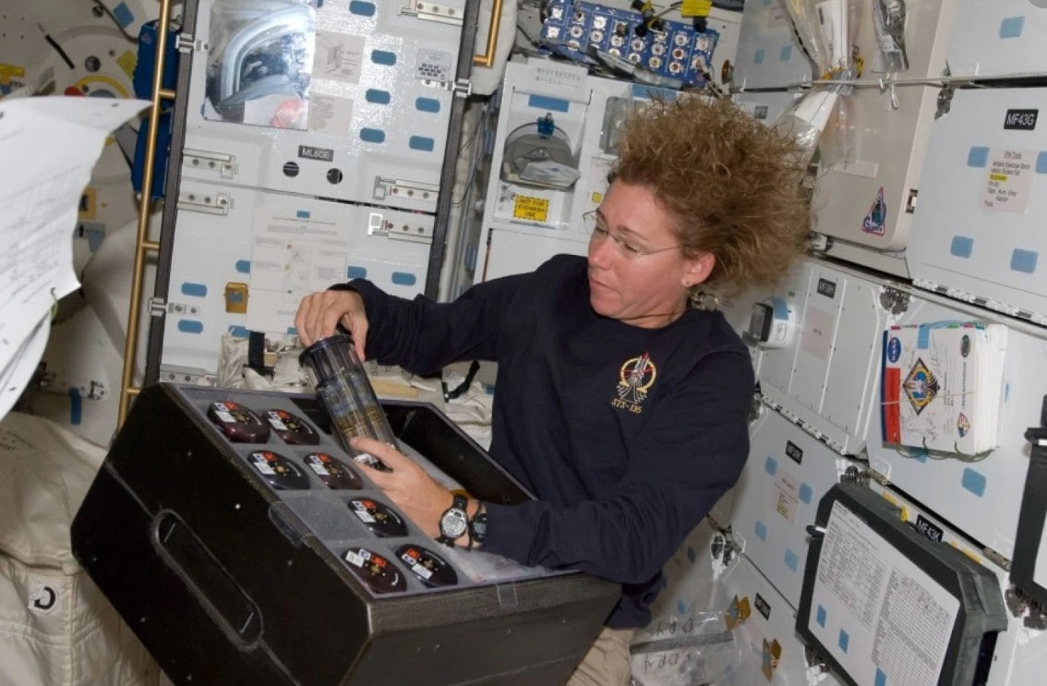
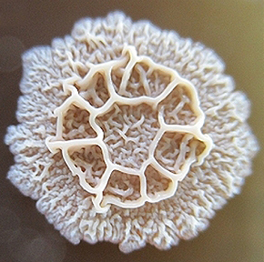
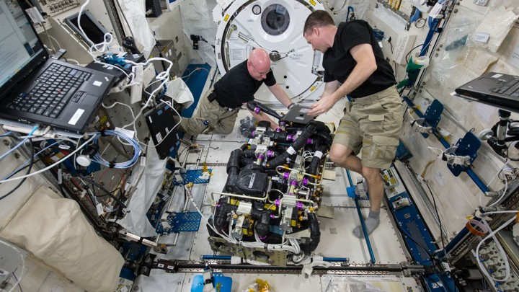
Space 101 : Microbes
What have we learned that could only be revealed in space?
Microbial Physiology and Genetics
Increased antibiotic resistance
Altered growth rate and metabolic activity
Increased environmental stress responses
Microbial Behavior
Spaceflight can change and alter bacterial biofilm formation
Host-Microbe Interactions
Microbes can modulate host innate immune system
Microbial Diversity and Tracking
Microbes on the ISS are similar to many microbes that are found in human microbiome
Notes:
Spaceflight conditions can change the formation of bacterial biofilms of some taxa and cause them to be thicker and form unique structures in microgravity.
Microbial Diversity – Molecular microbial community analyses have shown thousands of different microbial (i.e., bacterial, archaeal, and fungal) taxa on the ISS with many species similar to those found in the human microbiome.
Microbial Tracking – New rapid analysis tools have been developed to identify the microbes associated with both the astronauts and spacecraft to closely monitor how microbial diversity changes overtime aboard spacecraft and payloads.

Slide 5
Space 101 : Microbes
What is the frontier for microbial space research?
Microbiome of Astronauts
What are the long-term impact(s) of spaceflight on the normal healthy microbiome?
Microbiome of Spacecraft
Microbial exchange
Do the interior surfaces of spacecraft harbor harmful microbes?
How are microbes transmitted between crew, plants, and spacecraft systems?
Microbial Physiology
Planetary Protection
Mechanisms, Mechanisms,
Mechanisms
How do we minimize or avoid microbial contamination of spacecraft or other worlds?
Notes:
The Microbiome of Astronauts– What is the long-term impact of spaceflight on the normal healthy microbiome of astronauts and how do we mitigate the onset of disease during spaceflight?
Microbial Stress Response– How do microbes change their genetic or metabolic activities under stress conditions of spaceflight?
Planetary Protection– How do we minimize or avoid microbial contamination of spacecraft using the ISS as test-bed. Such technologies enable NASA to prevent potential harmful extraterrestrial agents from negatively affecting Earth?

