Slide 1
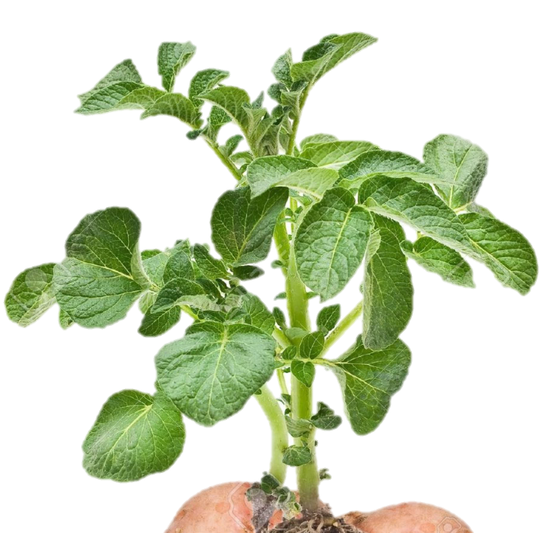
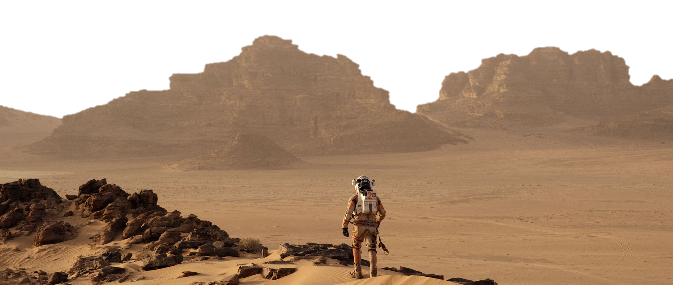
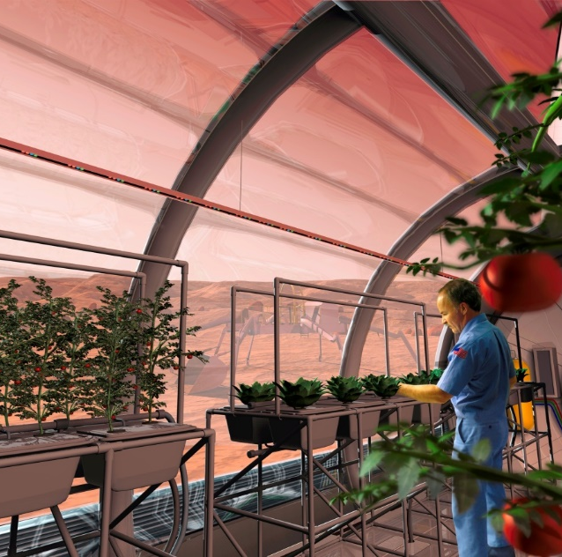
Light, CO₂ and water go in…
O₂
CO₂
oxygen, carbohydrates and clean water come out
Space Science 101- Plants
Anna-Lisa Paul
University of Florida

Slide 2
Why is Plant Science important to Space Research?
Bioregenerative Life Support systems
Planetary nutrition (and ISRU)
recycling of air, water and waste materials
human happiness in remote and isolated environments
Why is Space Research important to Plant Science?
Spaceflight habitats reveals fundamental answers about the workings of plants that are otherwise masked in Earth’s gravity.
We also need these answers to enable us to successfully grow plants off the surface of the Earth.

Slide 3
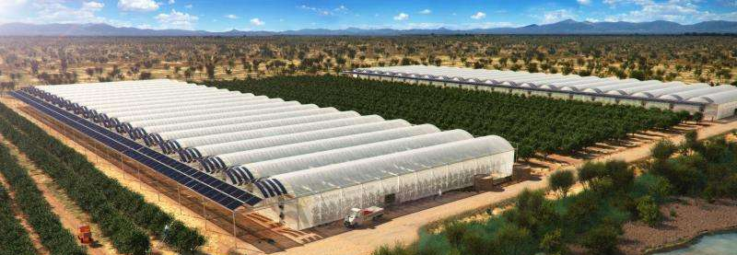
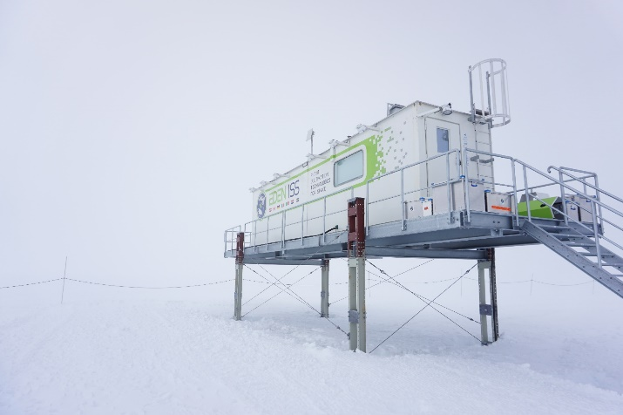
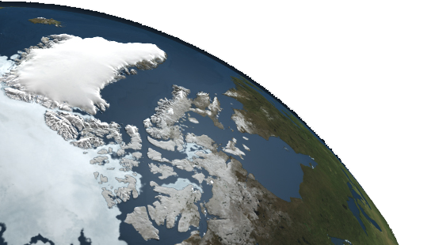
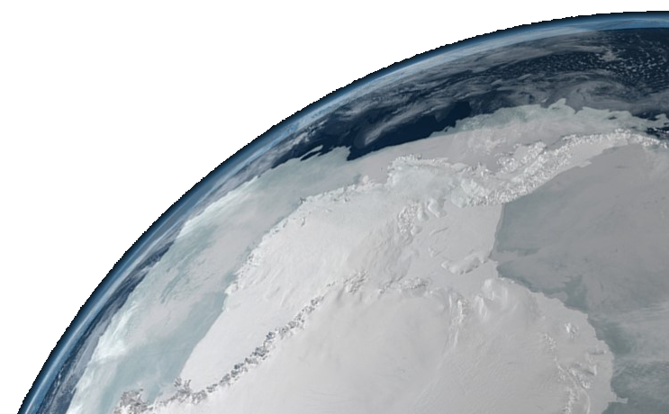
Why is Plant Space Research important to Earth?
Fundamental insights into plant space biology informs all branches of terrestrial plant science
Novel environment of spaceflight also contributes to predicting how plants will respond to novel terrestrial stresses
Optimizing closed plant habitats for challenging terrestrial environments
Research supported by NASA , CASIS, FSGC and the University of Florida

Slide 4
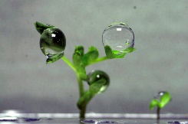
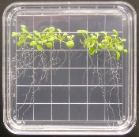
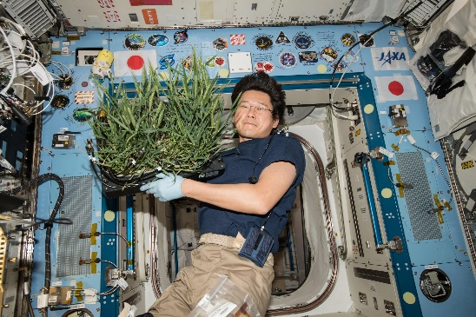
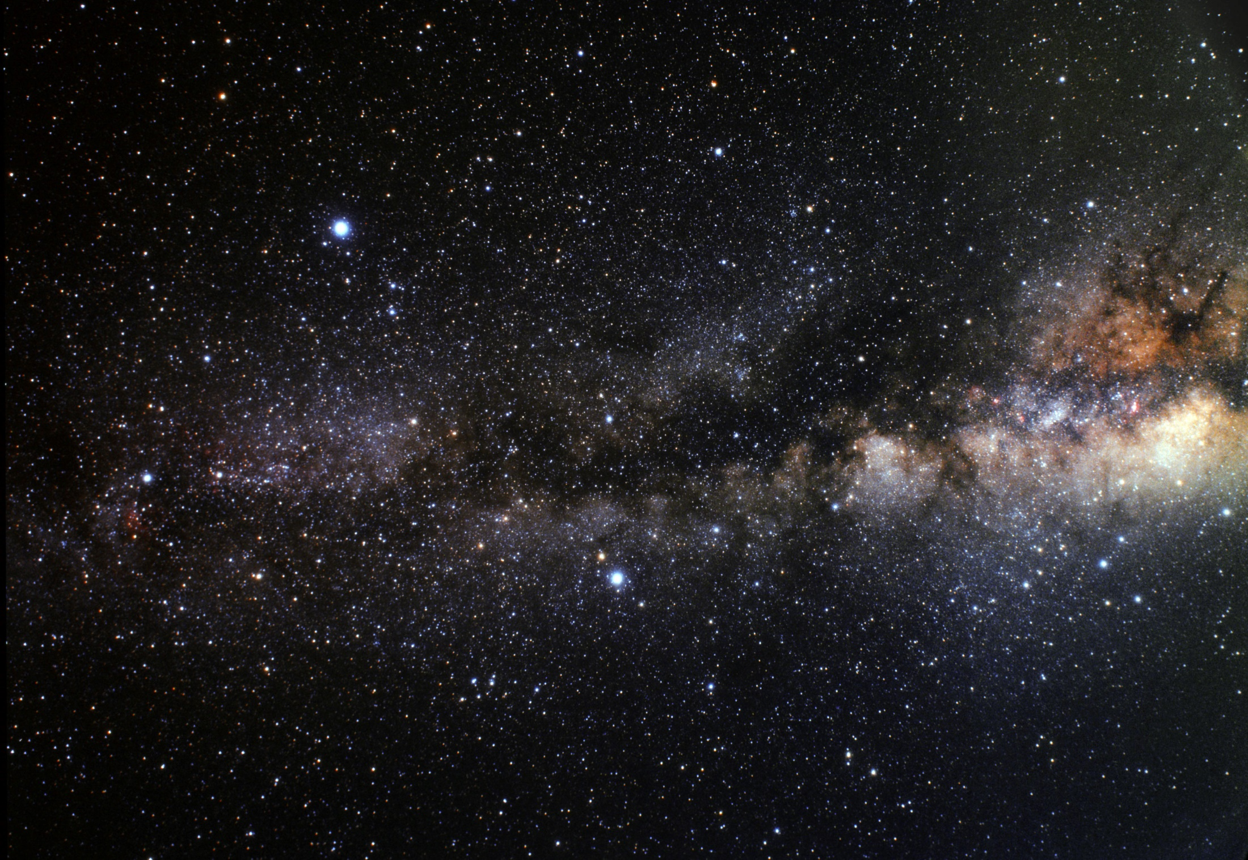
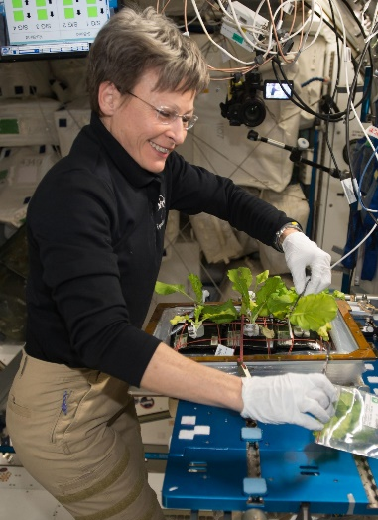
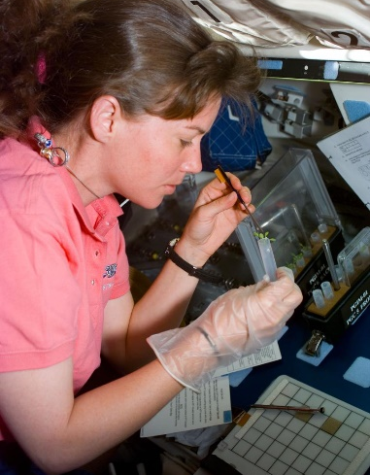
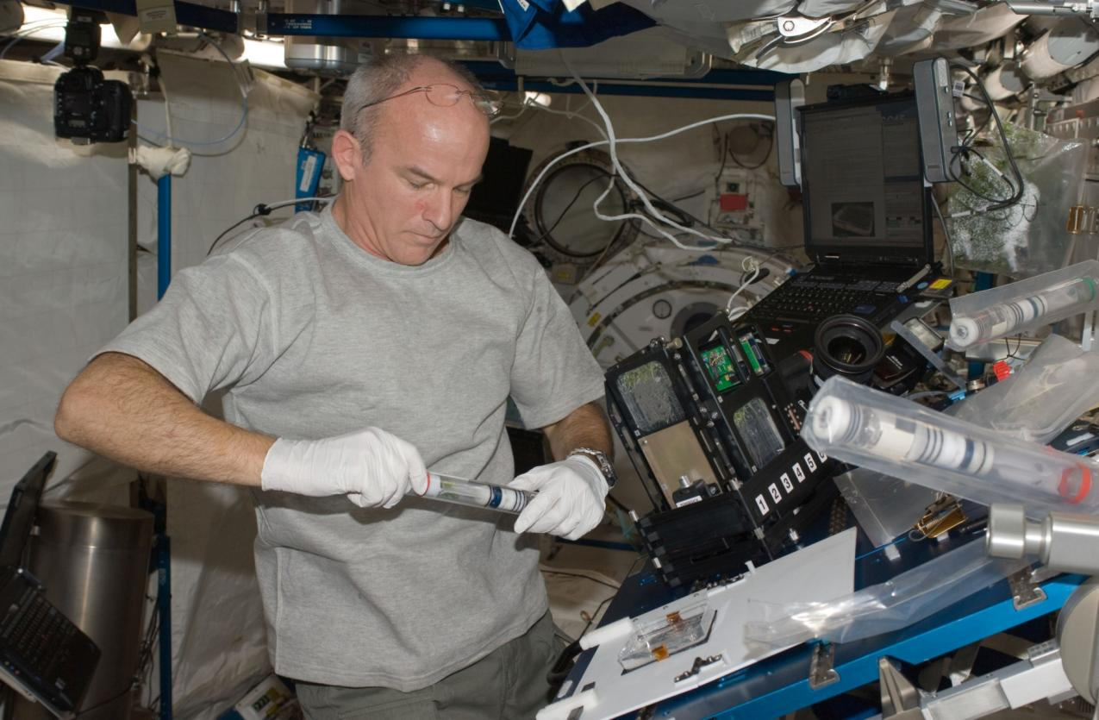
What have we learned about plants that could only be revealed in the spaceflight environment?
Plant tropisms – In the absence of gravity, plants use other cues to navigate
New insights into features of plant growth masked by Earth’s gravity
Reproduction and development – gravity is not required
Gene Expression and Genetics – plants change their patterns of gene expression in response to the spaceflight environment:
cell wall remodeling and oxidative stress
genotype is important, and evidence suggests we can select or engineer genomes to be better adapted to spaceflight
not all changes in gene expression are due to the lack of gravity, as shown in experiments with on-board centrifuges
epigenomic changes are induced by spaceflight environment

Slide 5
Why Plants?
Plants enable us to Explore past the restriction of a picnic basket
Plants enable us to survive in places where resources are limiting
When we leave Earth’s orbit, we will take plants with us.

