Slide 1
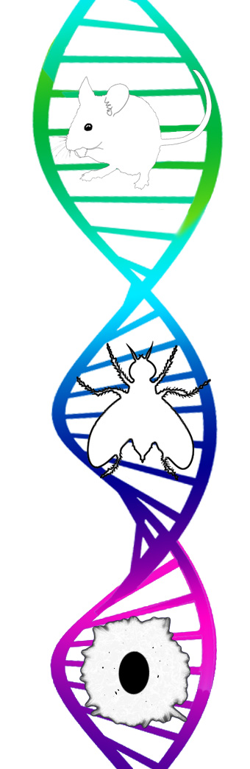
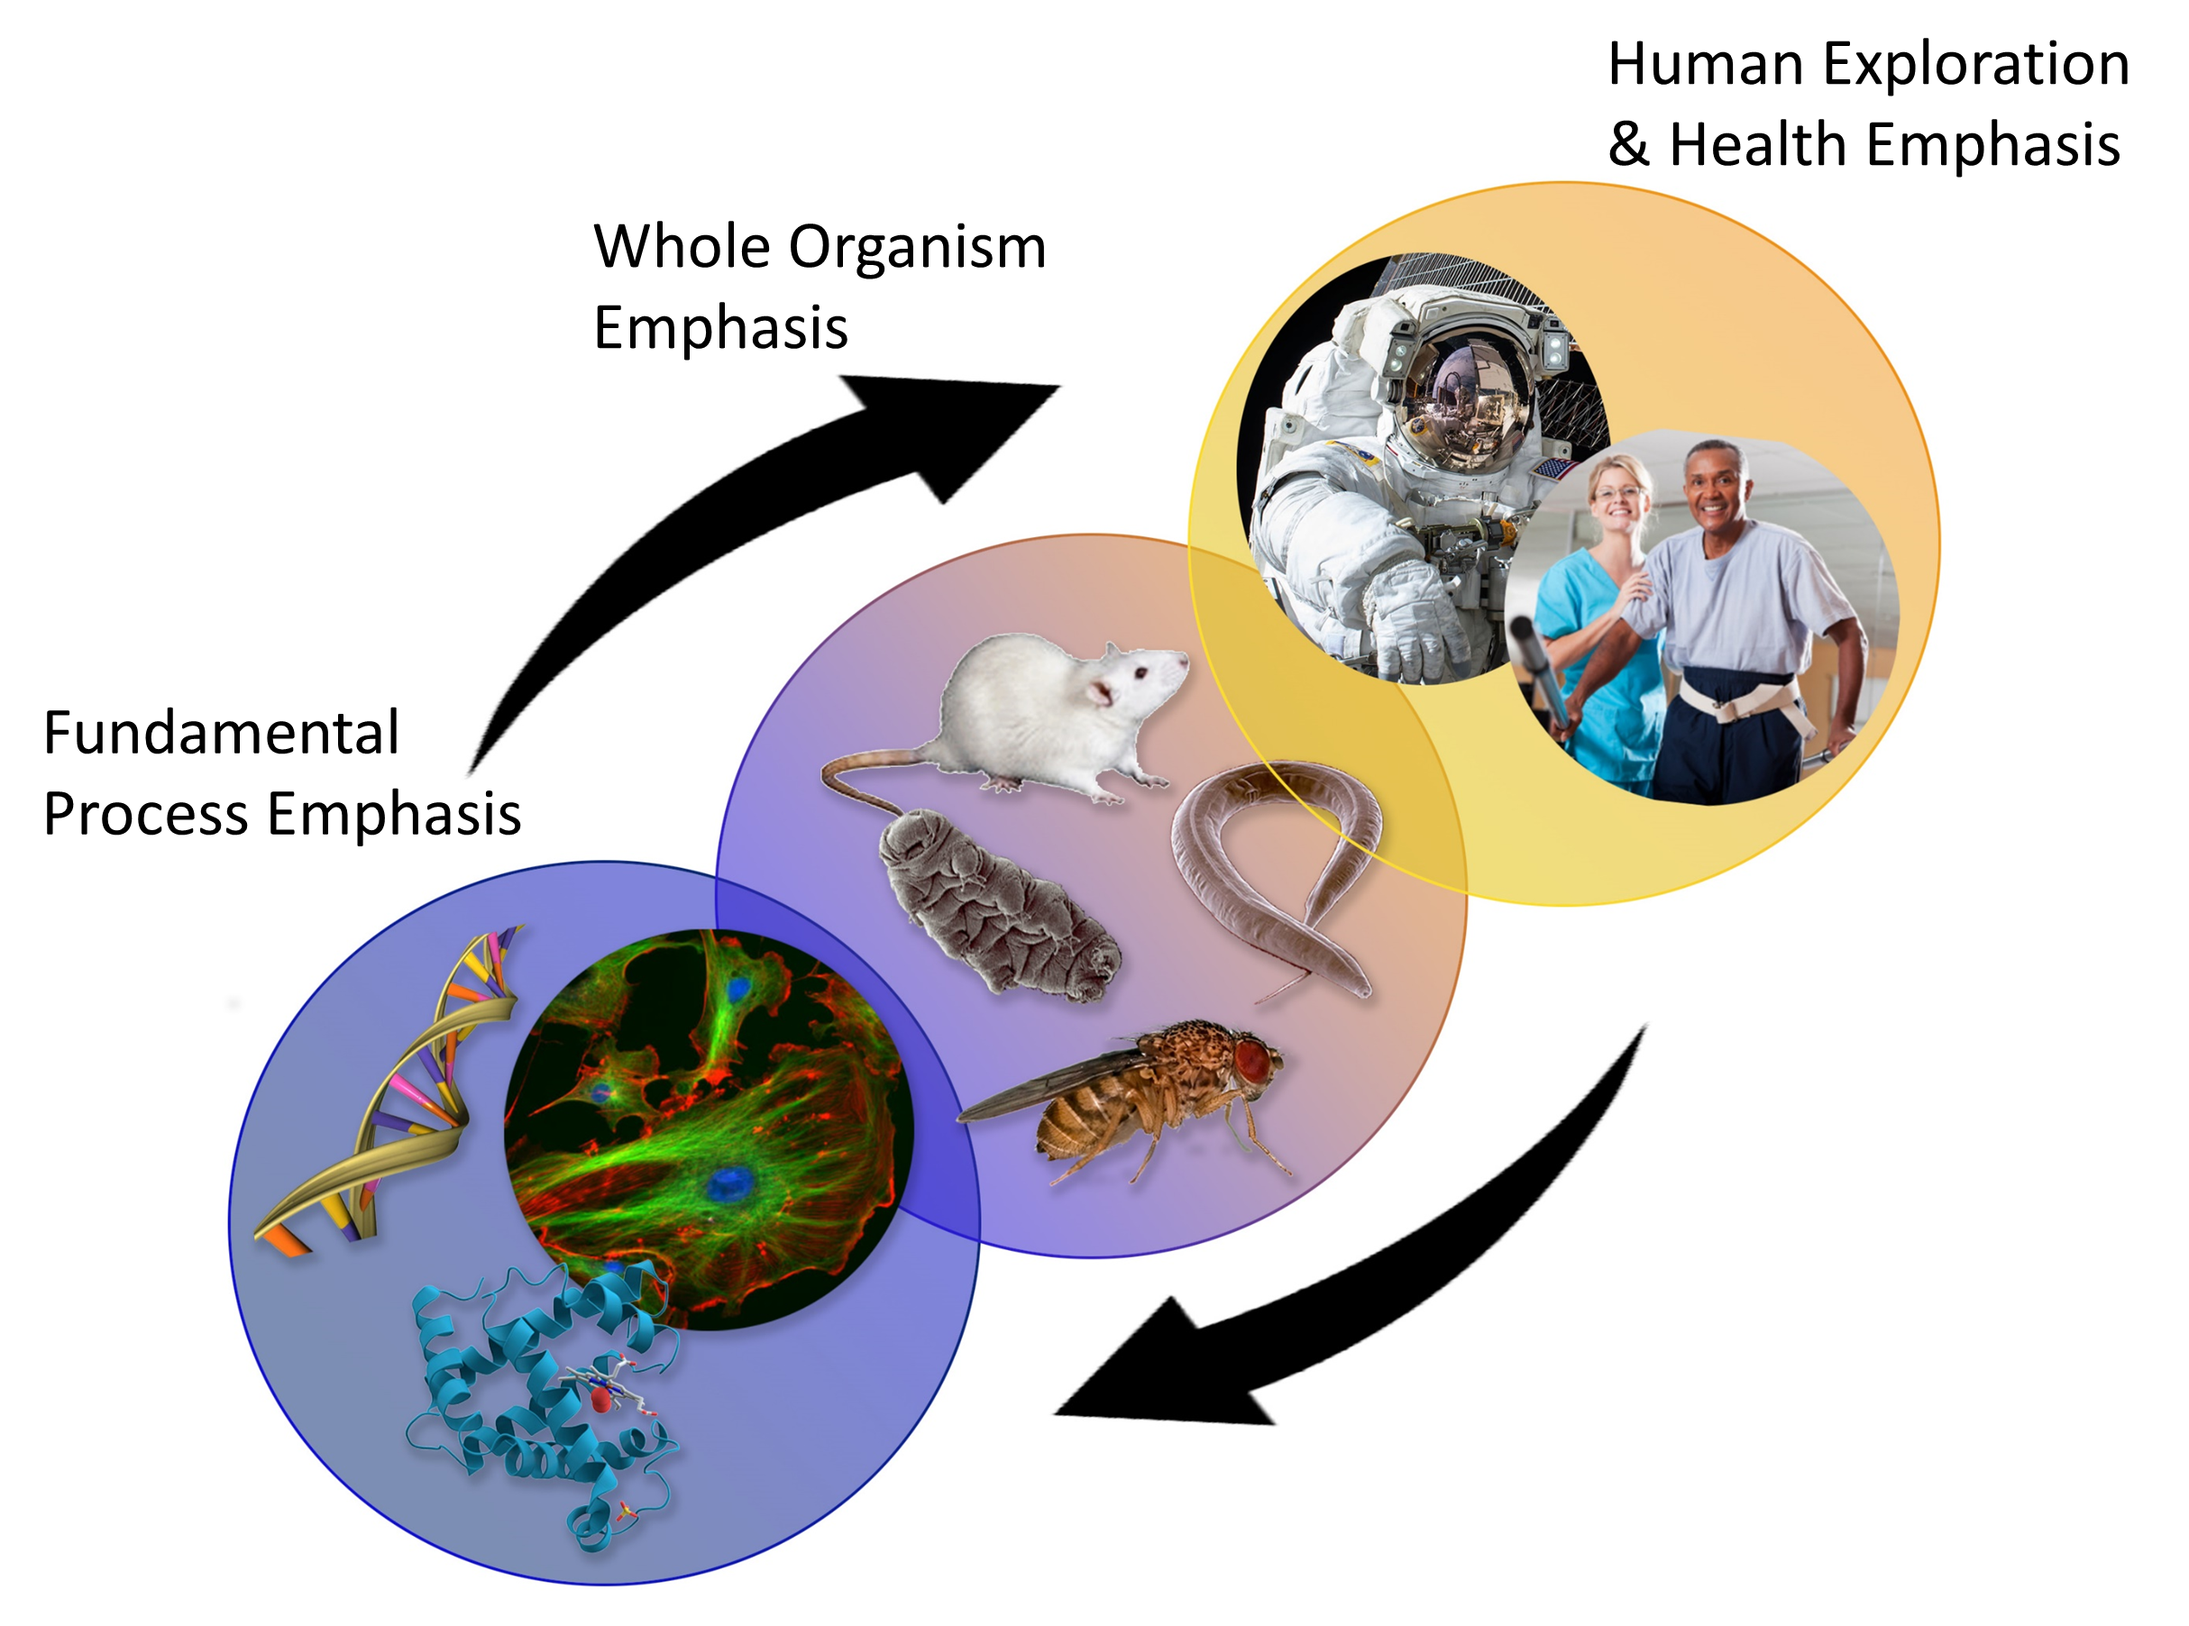
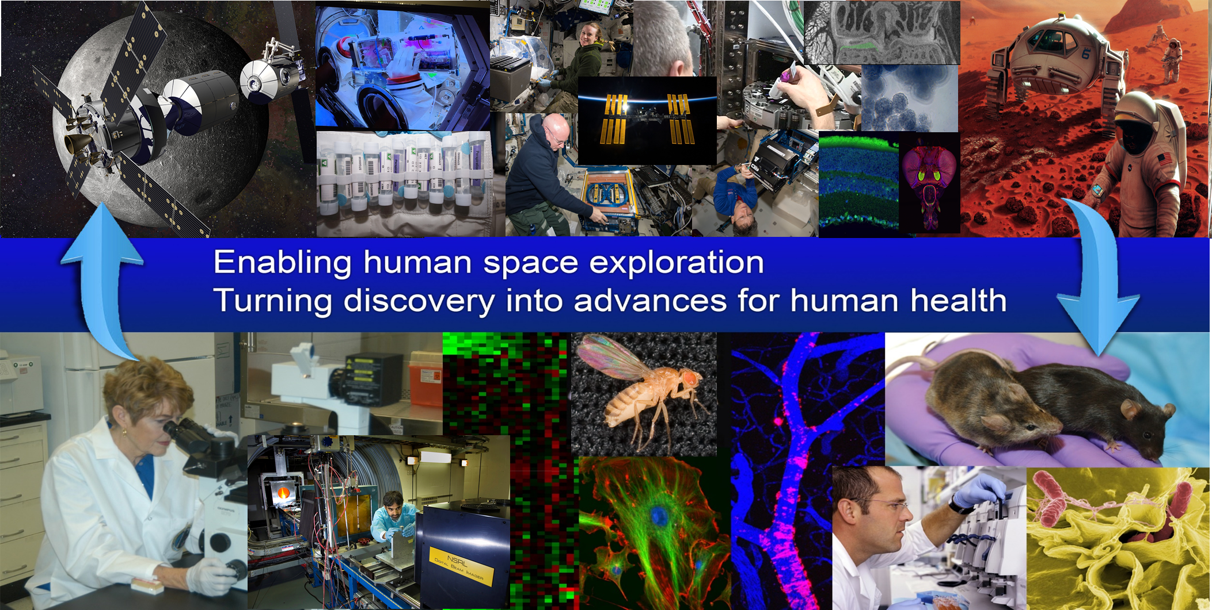
Space Science 101 – Non-Human Vertebrates and Invertebrates: Cells, Tissues, Systems
Jack van Loon, VU-Univ. Amsterdam, NL
Sharmila Bhattacharya, Amber Paul, Kevin Sato; NASA-Ames, CA , USA
Michael Pecaut, Xiao Mao; Loma Linda Univ., CA, USA

Slide 2
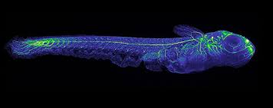
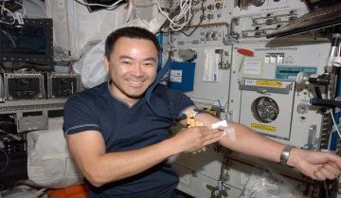
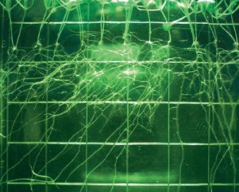
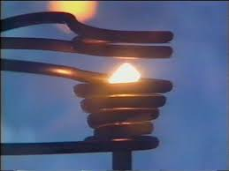
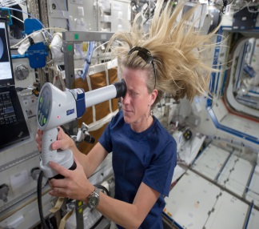
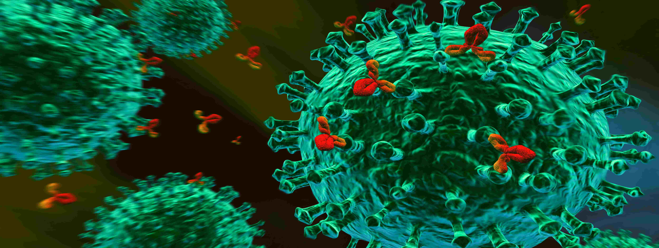
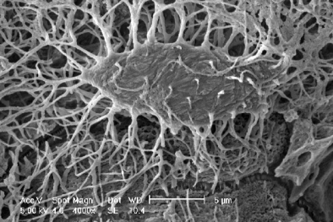
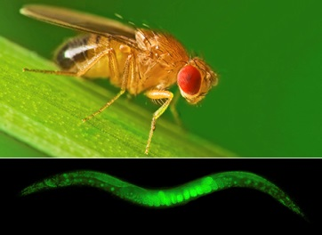
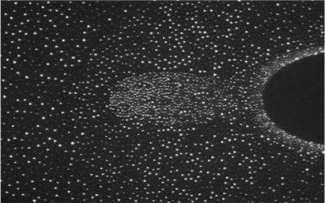
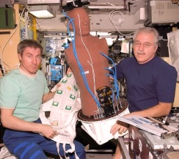
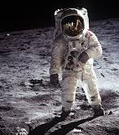
Why Gravity Related Research ?!
Basic Science
Operational Science
(Exploration)
Akihiko Hoshide
Karen Nyberg
Frank de Winne
blood draw
plant growth
melts
Ocular Health (OH) Fundoscope Exam
Muscle / Bone loss
Paulo Nespoli
Tim Peake
Akihiko Hoshide
LMM
Bose-Einstein Cond.
Blood draw
Plant (food) growth
prep. colloid exp.
Technology / two phase flow
Radiation
Matroshka
Exploration
osteocyte
developmental / omics
complex plasma

Slide 3
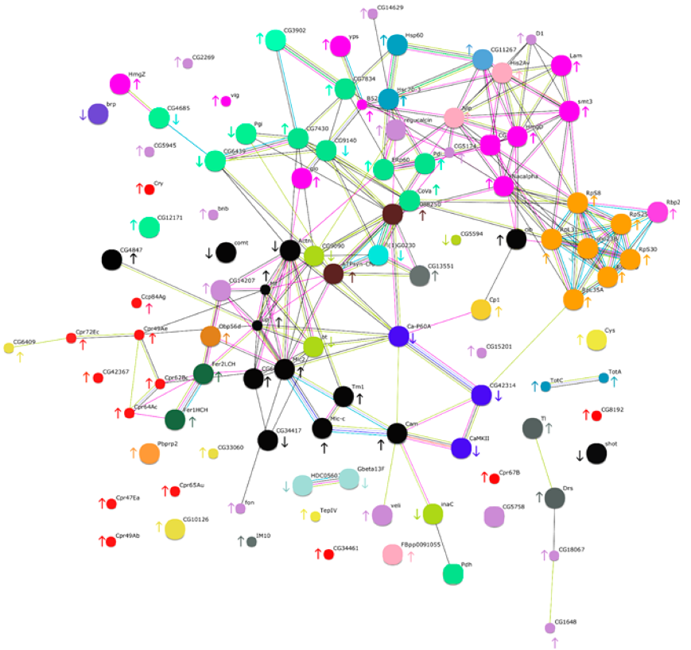
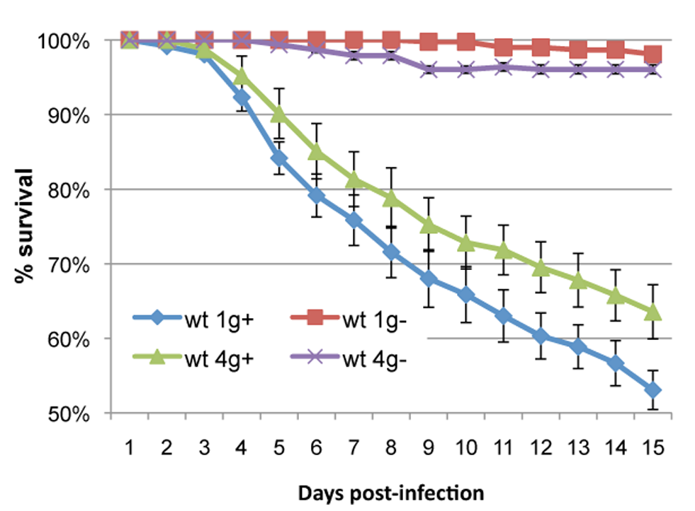
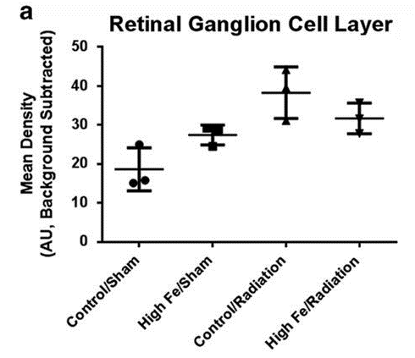
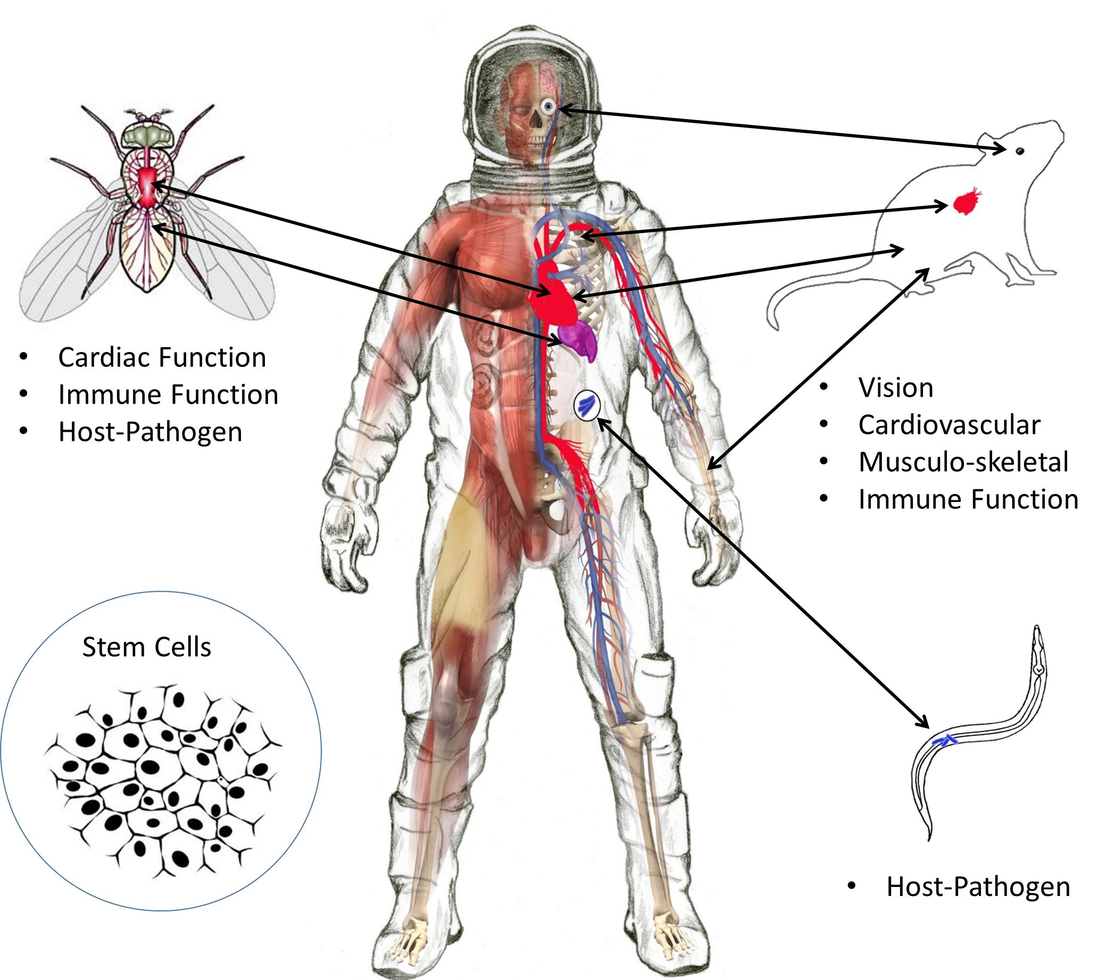
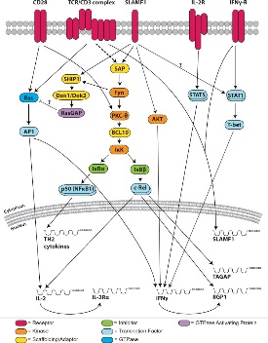
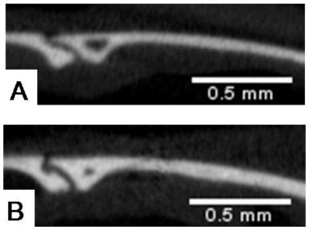
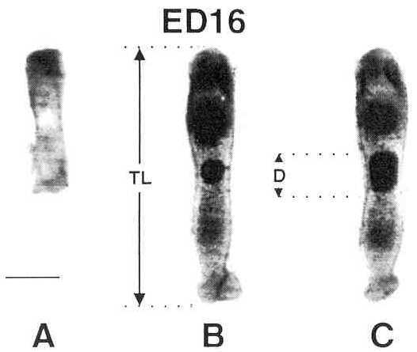
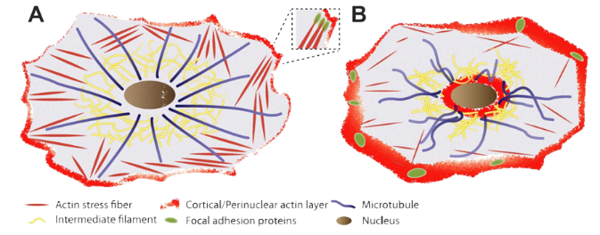
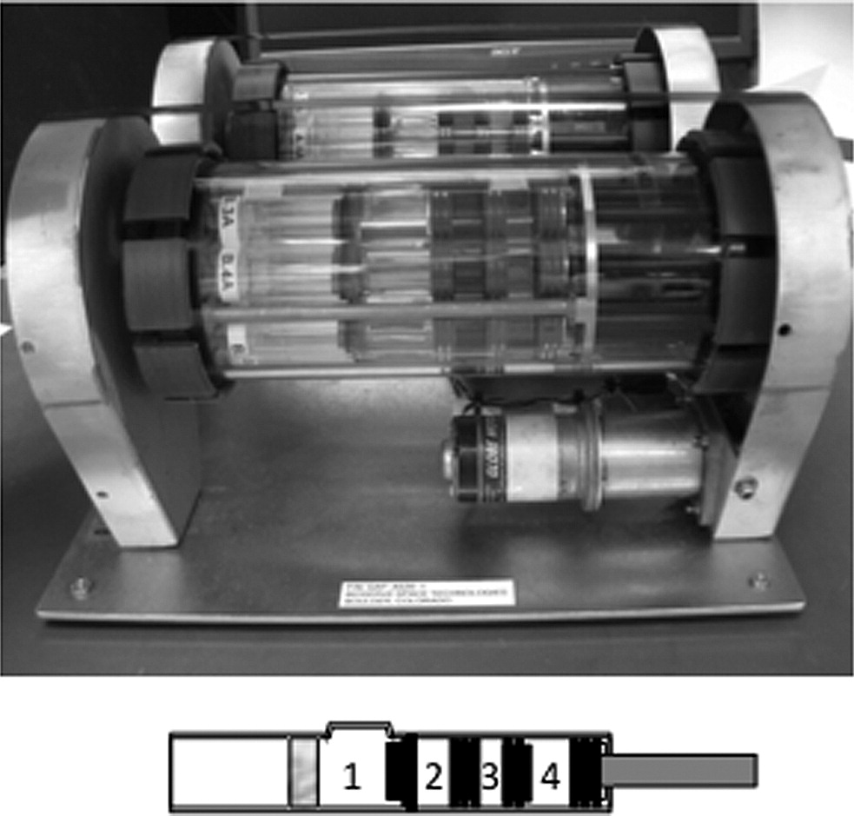
Background on cell, tissue and animal research.
proteomics
(innate) immunity: µg
(innate) immunity: hyper-g
Hosamani et al. J. Proteome Res. 2016
Marcu et al. PlosOne 2011
Taylor et al., PlosOne 2014
signal transduction
Theriot et al. npj Microgravity 2016
Brain/Neurobehavioral
µg
T_{o}
µg
1g
Martinez et al. Am J Physiol Regul Integr Comp Physiol. 2015
Zhang et al., Bone 2013
van Loon et al., JBMR 1995
cytoskeleton
Vorselen et al. FASEB J., 2014
Hammond et al. Astrobiology 2013

Slide 4
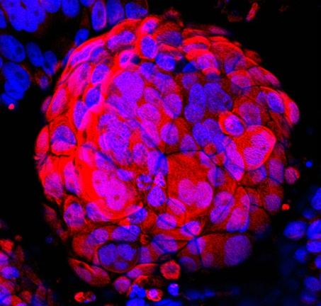
Relevance of Space Related Research in Cell, Tissue and Animal Physiology to Earth & Space Exploration
Unique Environment for Basic Research - e.g. Cell / Tissue Mechanosensing – No mechanical stress
3D cell clusters – Larger Constructs
Applied Research – Space Exploration
  bone / muscle / cardiovascular
  immune system (innate / adaptive response)
  cognition
Animals: changes on shorter timescales as humans
Explore the combined effects (micro-)gravity and radiation
Explore gravity continuum and g thresholds
McConkey et al. Science Advances 2016

Slide 5
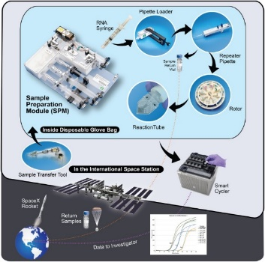
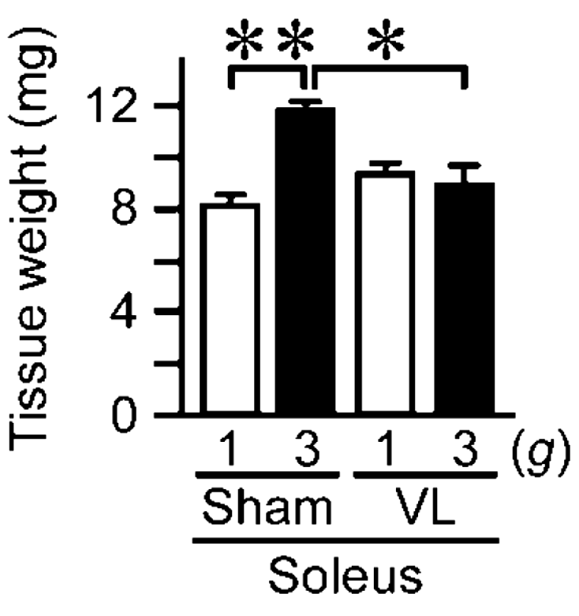
Important Questions – what do we need to know about cell, tissue and animal research to support space exploration?
Fundamental processes involved in:
  bone, muscle decrease (mass and strength)
  cardiovascular deconditioning
  compromised immune system
  basics behind reduced cognition
  …. all on genetics and proteomics level
Combined effect of near weightlessness and radiation
Interplay between organ systems (e.g. bone-bone marrow-immune, microbiome-gut-brain, vestibular – musculoskeletal)
Long term effects to health and re-adaptation to Earth following deep space travel and habitation
Pharmaceutical, dietary, physical, and psychological countermeasures needed to ensure health
Explore multiple development cycles (.. mammalian)
Shimbo et al. Exp. Anim. 2016
Parra et al., PlosOne 2017
Kawao et al., Physiol Rep 2016

Slide 6
What have we learned about cell, tissue and animal research that can only be revealed in the spaceflight environment?
Single cells are able to sense their near weightlessness (real & simulated) and hypergravity environment (cytoskeleton (FA), cell membrane, ..)
Cells adapt cytoskeleton, gene expression and functional output
Animal development (Drosophila, Xenopus, rodents) is possible in a near weightlessness environment although physiological and practical issues occur
Animals and single cells – show impaired innate and adaptive immune response
Various model systems show induction of oxidative stress response (can initiate a cascade of cellular and physiological changes)

Slide 7
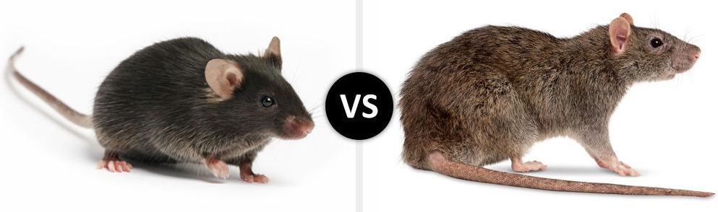
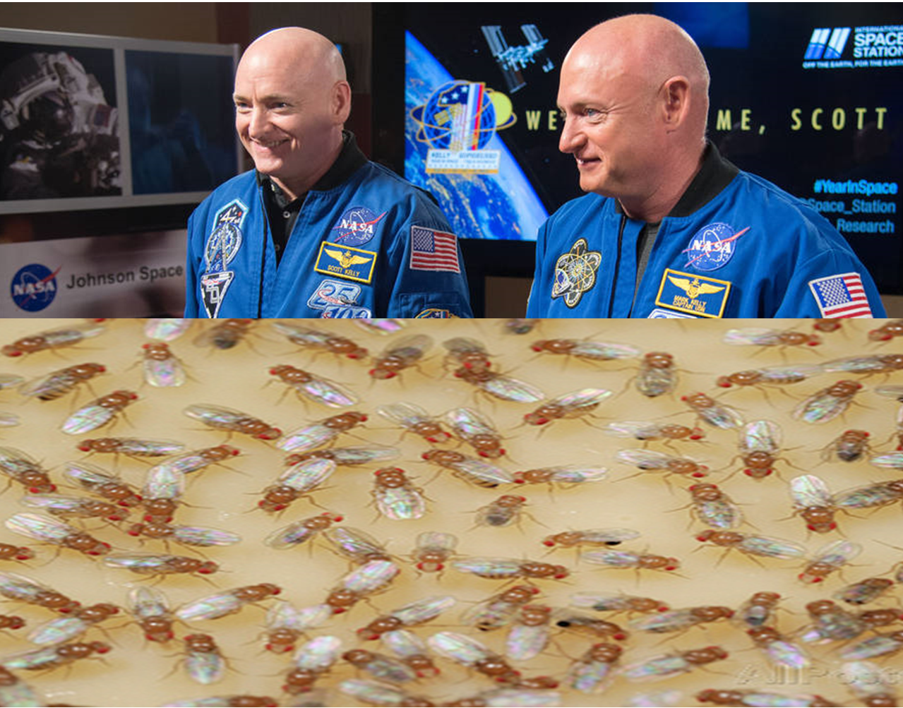
Pitfalls & Lessons Learned
microgravity vs. radiation
launch / landing effects
in-flight 1g control
in-flight storage
time of landing and sample collection
animal: habitat configuration
# repeats, # samples
limited crew time (all)
species (g ‘requires’ mass)
ground based analogues:
  residual accelerations (RPM/clinostat/RWV)
  fluid motions (RPM/clinostat/RWV)
  isotropic field lines (levitation)
  still load on front legs (tail suspension)
Shimbo et al. Exp. Anim. 2016
Mao et al. Int. J. Mol. Sci. 2018,
differencebtw.com
NASA + www
Leguy et al., Grav. Space Biol., 2011

